Slide 1

Contraception
This publication was made possible by Grant Number TP1AH000081-01-01 from the Department of Health and Human Services, Office of Population Affairs; its contents are solely the responsibility of the authors and do not necessarily represent the official views of the Department of Health and Human Services.

Slide 2
Understanding Teen Pregnancy
In 2014, a total of 249,078 babies were born to women aged 15–19 years in the United States (CDC, 2017).
In Tennessee alone, there were 6,756 babies born to women aged 15–19 in 2014 (National Campaign, 2017).
In 2010, Tennessee spent $230 million tax dollars on teen pregnancy related expenses (National Campaign, 2017).
Pregnancy and birth are significant contributors to high school dropout rates among girls; only about 50% of teen mothers receive a high school diploma by age 22 (CDC, 2017).
Only 61% of working teen dads obtain a high school diploma (Mollborn, 2011).

Slide 3
How does pregnancy occur?
In order for a pregnancy to happen, a sperm cell must fertilize an egg.
This is most commonly going to occur through sexual intercourse.
Once sperm have been released in the vagina, they will travel through the cervix into the uterus and eventually to the fallopian tube where an individual sperm can fertilize an egg.
Once the egg is fertilized, the egg will travel into the uterus and embed itself into the uterine lining.

Slide 4
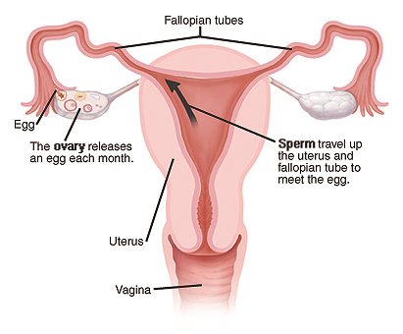
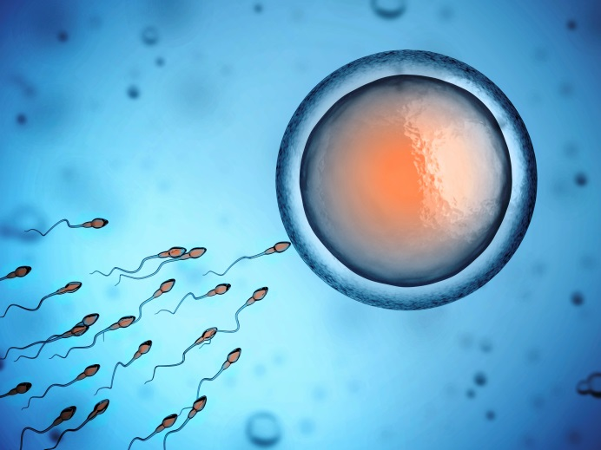

Slide 5
Our Position on Birth Control
Not assuming anyone is sexually active, but most will become sexually active at some point in their lives
Important to know how to protect yourselves in the event you become sexually active
Having the knowledge prepares you to make healthy decisions in the future
Recognize that everyone has different values
When sexually active, you may need to make informed decisions on how to reduce risk of unplanned pregnancy and/or STIs, including HIV

Slide 6
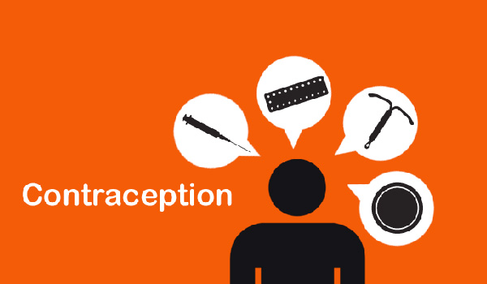
What is Contraception?
Any method to reduce the chance of unintended pregnancy.

Slide 7
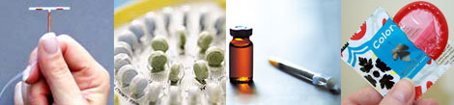
Types of Contraception
External Condoms
Internal Condoms
Birth Control Pills
The Patch
Vaginal Ring
IUD (hormonal and copper)
The Shot
The Implant
Diaphragm
Sponge
Spermicides
Abstinence

Slide 8
Types of Contraceptives
Over-the-counter methods:
Do not require an appointment with a medical provider or prescription. Can be found in drug stores, convenience stores, health departments, clinics
These include:
External condoms
Internal condoms*
Spermicides
Contraceptive sponges
Prescribed methods:
A medical provider visit and/or prescription are necessary. Most work by regulating hormones. They reduce the risk of pregnancy but DO NOT reduce the risk of STIs and HIV.
These include:
Diaphragms
Birth control pills
The patch
Vaginal ring
IUDs (hormonal and copper)
The shot
The implant
Free methods:
These methods do not require a medical provider appointment or prescription. Provided at no cost.
These include:
Abstinence
Internal Condoms*
External Condoms*
Notes:
*Internal condoms are available for free at Planned Parenthood and some health clinics, but only by RX at drug stores, some insurance covers them-they are considered a birth control method like pill, IUD, etc
*Condoms are often available for free. Always free at Planned Parenthood and health depts. Students often mention clinics, barber shops, teen centers, etc.

Slide 9
Over-the-Counter
Methods

Slide 10
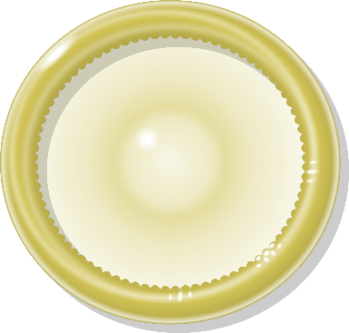

What?
Latex sheath that covers the penis.
Perfect use: 98% Typical use: 82%
When used consistently and correctly every time, condoms can reduce the risk of STIs including HIV.
No prescription or provider appointment necessary.
Can be difficult to remember, require commitment (must be used consistently and correctly every time to be effective).
No prescription necessary, can reduce the risk of pregnancy and STIs, cheap (or free) and easy to find.
Each individual condom is a one time use only (no rinsing/washing, flipping inside out, re-using)
Place condom on penis as soon as it is erect and remove after ejaculation (away from partner).
external condom
How?
If someone is allergic to latex, polyurethane or polyisoprene are alternatives. While lambskin condoms can reduce the risk of pregnancy, they are not recommended for protection from STIs.
How long?
How well?
STIs?
Doctor?
Drawbacks?
Benefits?
Notes:
External condoms can be used for vaginal, anal or oral sex. There are many varieties of colors, textures, sizes, brands and flavors. Flavored condoms only to be used for oral sex. Only water or silicone based lubricant are safe to use with condoms.

Slide 11
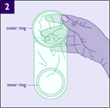
What?
Soft, loose-fitting polyurethane or nitrile sheath that lines vagina (or anus for anal sex).
Inserted right before sex, or up to 8 hours ahead of time.
Perfect use: 95% Typical use 79%
When used consistently and correctly every time, condoms can reduce the risk of STIs including HIV.
May need prescription to obtain from a pharmacy.*
May cause irritation of genital skin, requires commitment (must be used consistently and correctly to be effective).
Can be used if allergic to latex, everyone can be in control of their own protection.
Each individual condom is for one time use (no rinsing/washing, no flipping inside out, re-using)
internal condom
How?
How long?
How well?
STIs?
Doctor?
Drawbacks?
Benefits?
Notes:
Do not use with external condom. Can be used for vaginal or anal sex. Remove ring if inserting into the anus.
*Internal condoms can sometimes be a little harder to find than traditional condoms. The only brand of internal condom that’s FDA approved and available in the U.S. is the FC2 Female Condom®. It’s available online at the FC2 Female Condom® website, at many Planned Parenthood health centers, family planning and health clinics (free of charge), and by prescription in drugstores. https://www.plannedparenthood.org/learn/birth-control/internal-condom/how-do-i-buy-internal-condoms

Slide 12
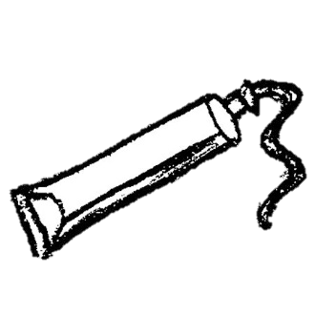

What?
Creams, films, foams, gels and suppositories that contain chemicals that stop sperm from moving
Inserted into the vagina, so it also keeps sperm from getting through the cervix and into the uterus.
Different for different products. Many require 10-minute wait between application and sexual contact.
Perfect use: 82% Typical use: 72%
Does not protect against STIs or HIV. Using a condom consistently and correctly will help reduce the risk of STIs.
No prescription or provider appointment necessary.
Chemicals in spermicides can raise risk for HIV infection*, may irritate skin, can be messy.
Easy to use, easy to find, does not affect hormones, can be used while breastfeeding.
How?
spermicide
How long?
Spermicide is most effective when used with another method, such as a condom.
How well?
STIs?
Doctor?
Drawbacks?
Benefits?
Notes:
*Raises risk for HIV due to potential inflammation in the vagina caused by chemicals like nonoxynol-9 frequently used in spermicidal products.

Slide 13
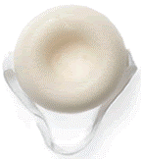
What?
Round piece of white plastic foam (about 2” across) with a little dimple on one side and a nylon loop across the top.
Inserted into the vagina before vaginal intercourse. Blocks the cervix and releases spermicide.
Perfect use: 80-91% Typical use: 76-88%
Not effective against the spread of STIs/HIV. Consistent and correct condom use still necessary to reduce risk of STIs.
No prescription or provider appointment necessary.
Inserting can be difficult/uncomfortable, may cause irritation, unpredictable effectiveness, requires discipline/planning, not widely available.
Will not affect hormones, no prescription necessary, can be inserted 24 hours in advance, may be used while breastfeeding.
Once inserted, it can be left in for up to 30 hours. Must be left in at least 6 hours after vaginal intercourse.
How?
the sponge
How long?
How well?
STIs?
Doctor?
Drawbacks?
Benefits?

Slide 14
Prescribed
Methods

Slide 15
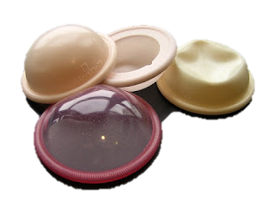
What?
Shallow, dome-shaped cup made of silicone (2 different kinds available in the U.S.)
Inserted into the vagina to cover the cervix. May be used with spermicide to increase effectiveness.
Must be left in for 6 hours after last vaginal intercourse.
Perfect use: 94% Typical use: 88%
Not effective against the spread of STIs/HIV. Consistent and correct condom use still necessary to reduce risk of STIs.
A provider visit and prescription are necessary to obtain this method. Sometimes a fitting will be necessary.
Can be difficult to insert, requires planning, can get pushed out of place, may cause irritation or urinary tract infections.
Will not affect hormones, can be inserted before needed, multiple uses, decreases risk of pelvic inflammatory infection, can be used while breastfeeding.
How?
diaphragm
How long?
How well?
STIs?
Doctor?
Drawbacks?
Benefits?

Slide 16
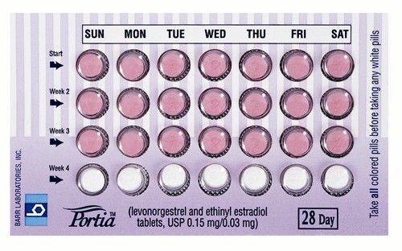
What?
A pill taken at the same time every day that releases hormones: estrogen and progestin. Some types are only progestin.
Hormones prevent ovulation (when an egg is released from an ovary) and thicken the cervical mucus to help keep sperm from fertilizing an egg.
Taken at the same time each day to ensure a consistent level of hormones. Several days after discontinuing use, fertility can return.
Perfect use: 99% Typical use: 91%
Not effective against the spread of STIs/HIV. Consistent and correct condom use still necessary to reduce risk of STIs.
A prescription is necessary to obtain this method.
Requires discipline to remember, possible early side effects: occasional spotting, sore breasts, nausea (will likely go away after 2-3 months).
Control over timing of periods, easy to use, may reduce acne, may reduce menstrual cramps.
birth
control pills
How?
How long?
How well?
STIs
Doctor?
Drawbacks?
Benefits?
Notes:
The fourth week of pills do not contain hormones to allow for menstruation. Pills can also be taken continuously if advised by a medical professional.

Slide 17
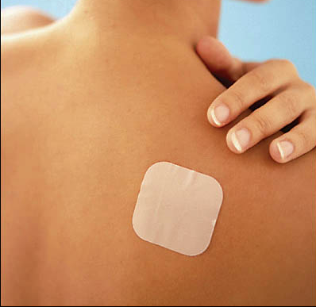
What?
Small, thin adhesive that resembles a Band-Aid and contains hormones.
You wear the patch on your belly, upper arm, butt, or back. Your skin absorbs the hormones into your body. It prevents ovulation and thickens cervical mucus.
Changed at the same time each week for 3 weeks, and removed the fourth for someone’s period. May also be worn continuously by placing a new patch on every 3 weeks (if advised by doctor)
Perfect use: 99% Typical use: 91%
Not effective against the spread of STDs/HIV. Consistent and correct condom use still necessary to reduce risk of STDs.
A medical provider visit and prescription are necessary to obtain this method.
May not work for those over 198 lbs, possible bleeding in between periods, breast tenderness, nausea (for first 2-3 mo.), possible skin irritation.
Easy to use, relatively little effort, more regular periods, may clear up acne, can reduce menstrual cramps.
the patch
How?
How long?
How well?
STIs?
Doctor?
Drawbacks?
Benefits?

Slide 18
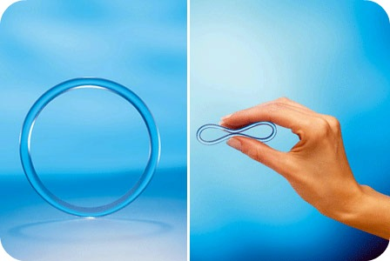
What?
Small, flexible ring inserted into the vagina that contains hormones.
Hormones are absorbed directly through the cervix to prevent ovulation and thicken cervical mucus.
Inserted and worn for 3 weeks and removed on the fourth week for someone’s period. Can also be worn continuously for up to 5 weeks before a new ring must be inserted.
Perfect use: 99% Typical use: 91%
Not effective against the spread of STIs/HIV. Consistent and correct condom use still necessary to reduce risk of STIs.
A medical provider visit and prescription are necessary to obtain this method.
Must be stored in fridge, possible spotting, breast tenderness, or nausea (first 2-3 mo.); possible increased vaginal discharge, irritation, or infection long term.
Easy to use, relatively little effort, may clear up acne, can reduce menstrual cramps, lower dose of hormones than other hormonal methods.
the
ring
How?
How long?
How well?
STIs?
Doctor?
Drawbacks?
Benefits?

Slide 19
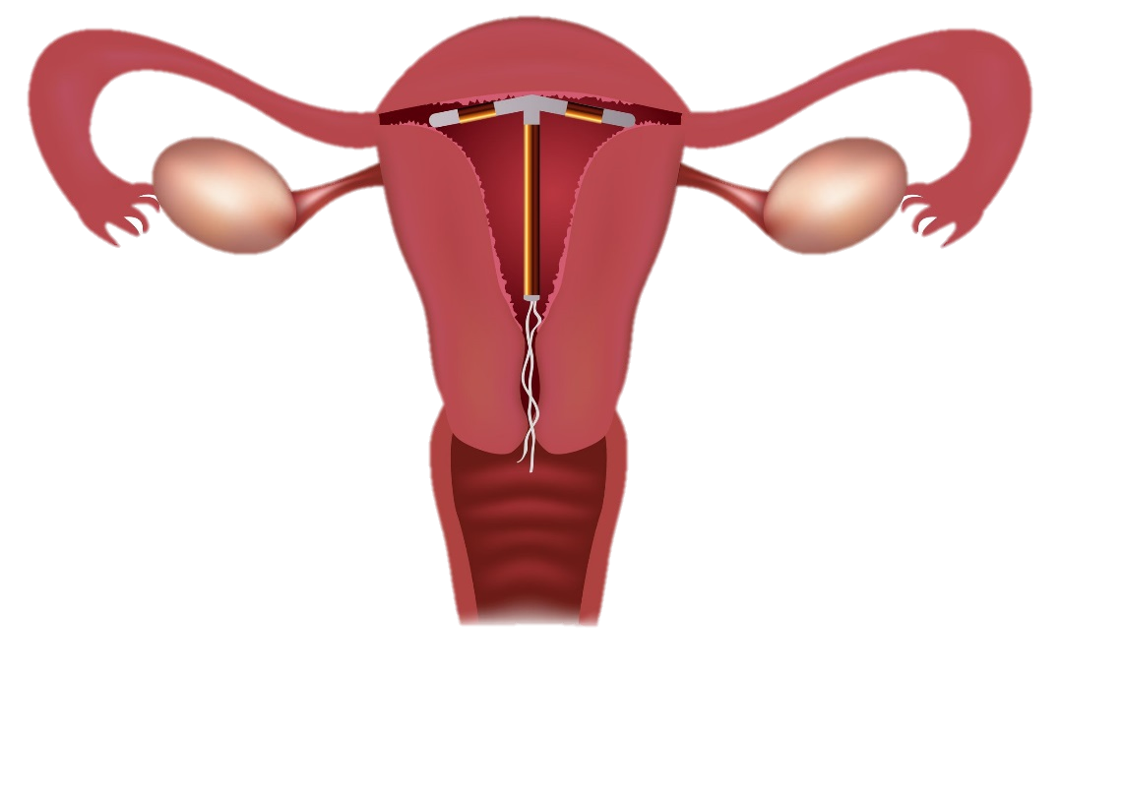
Small, t-shaped piece of plastic or plastic/copper inserted into the uterus by a doctor.
2 types of IUDs in U.S. Hormonal: made of plastic and release progestin, preventing ovulation and thickens cervical mucus. Non-hormonal: contain a small amount of safe, natural copper. It affects sperm’s ability to move in the uterus to keep them from fertilizing an egg.
Once inserted, hormonal IUDs can be effective for 3-7 years (depending on the brand). Non-hormonal IUDs can be effective for up to 12 years.
Perfect use: greater than 99% Typical use: greater than 99%
Not effective against the spread of STIs/HIV. Consistent and correct condom use still necessary to reduce risk of STIs.
Medical provider visit is necessary for insertion and removal.
Pain with insertion, possible spotting in between periods, cramps and backaches. Non-hormonal users could have increased period flow. Can be expensive without insurance.
Long-term protection with little effort, easy to conceal, hormonal IUDs can make periods lighter, non-hormonal IUDs do not affect hormones, can be used while breastfeeding and for emergency contraceptive.
What?
IUD
(intra-uterine
device)
How?
How long?
How well?
STIs?
Doctor?
Drawbacks?
Benefits?
Notes:
Cervix must be dilated for insertion. Some doctors are hesitant to suggest this method for those that have never given birth/had their cervix dilated. There are brands of hormonal IUDs that are designed to be smaller and easier to insert for teens/ those that haven’t given birth.
Types/brands of IUDs: https://www.bedsider.org/features/70-paragard-vs-mirena-which-iud-is-best-for-you

Slide 20
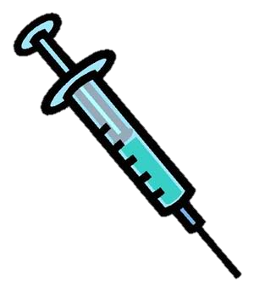
What?
A shot containing progestin that is given every 3 months.
Progestin works to prevent ovulation and thicken cervical mucus to keep sperm from fertilizing an egg.
Must receive shot every 3 months.
Perfect use: greater than 99% Typical use: 94%
Not effective against the spread of STIs/HIV. Consistent and correct condom use still necessary to reduce risk of STIs.
Medical provider or clinic visit is necessary to get the shot.
Possible irregular bleeding (esp. for first 6-12 months), change in appetite or weight gain; less common side effects are hair loss, dizziness, headache, nausea.
Easy to conceal, may cause shorter/lighter periods or no period at all, long-term protection with little effort, can be used while breastfeeding.
the shot
(Depo-Provera)
How?
How long?
How well?
STIs?
Doctor?
Drawbacks?
Benefits?

Slide 21
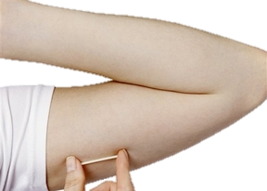
What?
Thin stick about the size of a match that is inserted under the skin of the upper arm by a medical professional.
The implant releases progestin, which prevents ovulation and thickens cervical mucus to keep sperm from fertilizing an egg.
Once inserted, the implant is effective for up to 5 years.
Perfect use: greater than 99% Typical use: greater than 99%
Not effective against the spread of STIs/HIV. Consistent and correct condom use still necessary to reduce risk of STIs.
An appointment with a medical provider is necessary for insertion and removal.
Possible irregular bleeding (esp. in first 6-12 mo.); less common side effects: acne, headaches, discoloring or scarring of skin over implant, pain at implant site.
Long-term protection, very little effort, easy to conceal, fewer/lighter periods, can be used while breastfeeding.
the
implant
(Nexplanon)
How?
How long?
How well?
STIs?
Doctor?
Drawbacks?
Benefits?

Slide 22
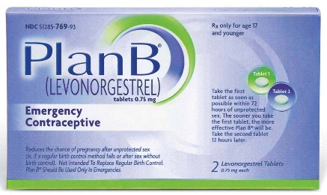
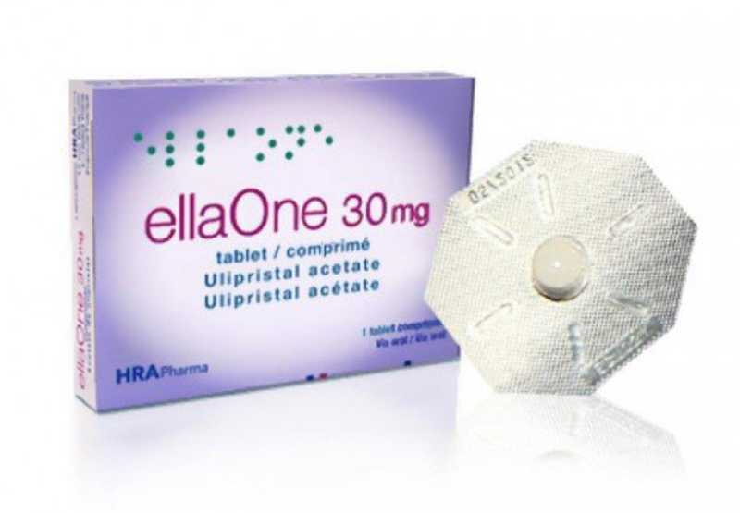
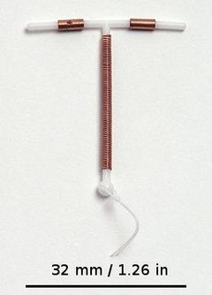
What?
Birth control that can be used after unprotected sex—if you did not use birth control/condom or your regular birth control failed. (EC is not to be used as regular birth control method)
emergency contraception
(Plan B, the morning after pill, Copper IUD)
Releases levonorgestrel (Plan B) or ulipristal acetate (Ella),which prevents ovulation by slowing down LH hormones. The copper in the IUD makes it hard for sperm to swim well enough to get to the egg.
*Perfect use: IUD over 99%, Plan B 85%, Ella 95% *Typical use: IUD over 99%, Plan B 75%, Ella 85%
Not effective against the spread of STIs/HIV. Consistent and correct condom use still necessary to reduce risk of STIs.*
Possible mild side effects: Nausea, vomiting, fatigue, breast tenderness, slight irregular bleeding. Can be expensive (EC pills $50-$70). Levonorgestrel pills may be less effective for those over 165 lbs.
How?
How long?
Must be taken 3 (Plan B) to 5 (Ella, Copper IUD) days after unprotected sex to be most effective.(Sooner you take, better chance of preventing pregnancy)
How well?
STIs?
Doctor?
Plan B is available over the counter. Ella requires prescription. Copper IUD must be inserted by a medical provider.
Drawbacks?
Benefits?
Some options available over the counter, can buy ahead of time (EC pills), no age restrictions, copper IUD can remain effective for up to 12 years,
Notes:
Emergency contraception is NOT the abortion pill. It will NOT end a pregnancy if someone is already pregnant.
*Effectiveness rates depend on how soon you take the pill, where you are in your menstrual cycle, weight and other factors.
*If you are taking EC due to unprotected sex, getting tested for STIs/HIV is also recommended.
*see more info about IUDs (side effects, benefits, etc) on slide 19
There are a few other brands/types of EC pills not listed, Ella and Plan B are most common. See more info in links below.
https://www.hhs.gov/opa/pregnancy-prevention/birth-control-methods/emergency-contraception/index.html
https://www.bedsider.org/features/850-how-well-does-emergency-contraception-work

Slide 23
Don’t forget about…

Slide 24

What?
Not engaging in oral, anal, or vaginal sex.
If sperm does not come into contact with a vagina, there is no risk for pregnancy.
As long as someone is abstinent, they are 100% protected from the risk of pregnancy.
The only 100% effective way to avoid the risk of STIs.
No provider appointment or prescription necessary.
Can be difficult to maintain (peer/partner pressure, media pressure, etc.).
No risk of pregnancy or STIs, no side effects, free.
How?
abstinence
How long?
How well?
100%
STIs?
Doctor?
Drawbacks?
Benefits?

Slide 25

How do I know which method to use?
Talk to parents, doctor, counselor, or another trusted adult
Ask questions
Think about it
  Am I ready?
  Do have all the information I need?

Slide 26

How can both partners be involved in using contraceptives?
Help pay for it
Go to doctor/clinic with partner
Wear a latex/polyurethane condom
Help remind partner to take pill or make appointment
Help decide which method to use
Ask questions
Be supportive

Slide 27
Remember…
To reduce the chance of an unplanned pregnancy and sexually transmitted infections, you have to use effective methods to lower your risk.
Condoms are the only birth control method that also reduce the risk of spreading/contracting sexually transmitted infections including HIV.
Abstinence or “not having sex” will offer 100% protection against the spread of sexually transmitted infections and pregnancy.

Slide 28
For more information visit
www.Centerstone.org/teen

Slide 29




