Slide 1
Fact or Fiction
Teen Sexual Health Toolkit 3.0
This publication was made possible by Grant Number TP1AH000081-01-01 from the Department of Health and Human Services, Office of Population Affairs; its contents are solely the responsibility of the authors and do not necessarily represent the official views of the Department of Health and Human Services.

Slide 2
Can you separate
FACT from FICTION?
How much do you know about how pregnancy happens? For each statement, respond if you think it is:
Fact
Fiction
or
Be prepared to explain your answer!

Slide 3
Oral sex can result in a pregnancy.
Fiction
Sperm has to meet with an egg for a pregnancy to occur. This only takes place when sperm enter the uterus through the vagina. However, a person can still get STIs from participating in oral sex.

Slide 4
Having sex in a pool, hot tub, or other body of water will prevent a pregnancy.
Fiction
Having sex in a body of water will not prevent pregnancy. Any time sperm meets with an egg inside the uterus, a pregnancy can occur. Water will not prevent semen from entering the vagina.
Notes:
A similar myth is that if someone ejaculates into a pool or hot tub it can get someone pregnant without penetration. A penis must ejaculate into the vagina for a pregnancy to occur.

Slide 5
Pulling the penis out of the vagina before ejaculation is an effective way to prevent pregnancy.
Fiction
Once a penis becomes erect, a small amount of pre-ejaculate is released. A person may not feel this and does not have any control over this. It only takes 1 sperm for a pregnancy to occur. Pre-ejaculate can also transmit STIs.
Notes:
Comprehensive note: If someone has already decided to engage in unprotected sex, “pulling out” is preferred to ejaculating into their partner. Pre-ejaculate contains much fewer sperm than ejaculation. Failure rate of “pulling out” is about 22% making the typical use effectiveness rate about 78%. This is risk reduction, but not prevention.

Slide 6
Pregnancy can happen during menstruation.
Fact
Ovulation (when an ovary releases an egg) occurs during a certain time in the menstrual cycle-anywhere from a few days up to two weeks after the period. Sperm can live in the body up to five days. So, there is a risk that sperm could still be present the next time ovulation occurs, and pregnancy is possible.

Slide 7
Having sex standing up will prevent pregnancy.
Fiction
Some people might think that gravity will cause sperm to fall out of the body. However, sperm are really good swimmers, so no amount of jumping up and down will prevent pregnancy.
Notes:
Although semen may leak out of the vagina after ejaculation, sperm may have already entered the cervix and into the uterus.

Slide 8
Drugs and alcohol make sex more risky.
Fact
Drugs and alcohol DO make sex more risky. One in five 15-17 year olds say they have done something sexually, while under the influence of drugs or alcohol, that they would not normally have done. That’s 20%!
Teens that are under the influence are also more likely to not use contraception if they do have sex.
Consent cannot be given or received while either person is under the influence.
In the context of sexual assault, this means that alcohol may make it easier for a perpetrator to commit a crime and can even prevent someone from remembering that the assault occurred.
Notes:
It’s important to stay safe while under the influence of alcohol, it’s also important to remember that sexual assault is never the victim’s fault, regardless of whether they were sober or under the influence of drugs or alcohol when it occurred.
https://www.rainn.org/articles/alcohol-safety

Slide 9
Urinating after sex can help prevent pregnancy.
Fiction
Urinating after sex has no effect on whether or not a pregnancy can occur because it is not the same opening of the body. The female reproductive system has two openings in the genital area;
1) The urethra-where urine leaves the body.
2) The vagina-where vaginal intercourse takes place, menstrual flow exits the body, and a baby is delivered.

Slide 10
Pregnancy can occur the first time a couple has sex.
Fact
ANY TIME sperm meets with an egg there is a possibility of pregnancy.

Slide 11
Missing a period is a definite sign of a pregnancy.
Fiction
While a missed period can definitely be a sign of pregnancy, there are many other causes of a missed period. Menstrual cycles can be irregular due to diet, stress, exercise or other reasons.
Notes:
If you think you may be pregnant, see a doctor for a pregnancy test (family doctor, health dept, Planned parenthood, other clinics)

Slide 12
Drinking Mountain Dew reduces sperm count.
Fiction
No amount of Mountain Dew will lower a sperm count. Food or drinks are not an effective way to prevent pregnancy.

Slide 13
Pregnancy By the Numbers
Time for a guessing game about pregnancy and reproduction!

Slide 14
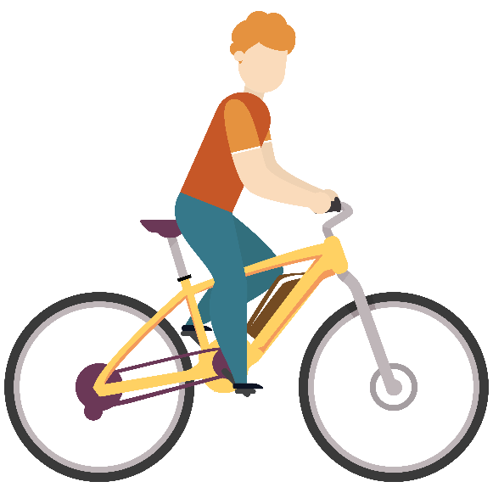
Take a guess!
____________ Average amount of sperm found in the semen of one ejaculation.
____________ Number of sperm it takes to create a pregnancy.
____________ Average number of days it takes the
body to create sperm.
80 - 300 Million
64
1

Slide 15
Take a guess!
80 – 300 Million
____________ Average amount of sperm found in the semen of one ejaculation.
____________ Number of sperm it takes to create a pregnancy.
____________ Average number of days it takes the body to create sperm.
1
64
Notes:
Sperm counts - OpenLearn - Open University

Slide 16
Take a guess!
____________ Average number of eggs contained in the ovaries by puberty.
____________ Average number of eggs ovulated during the lifetime.
500
300,000-400,000

Slide 17
Take a guess!
300,000-400,000
____________ Average number of eggs contained in the ovaries by puberty.
____________ Average number of eggs ovulated during the lifetime.
500

Slide 18
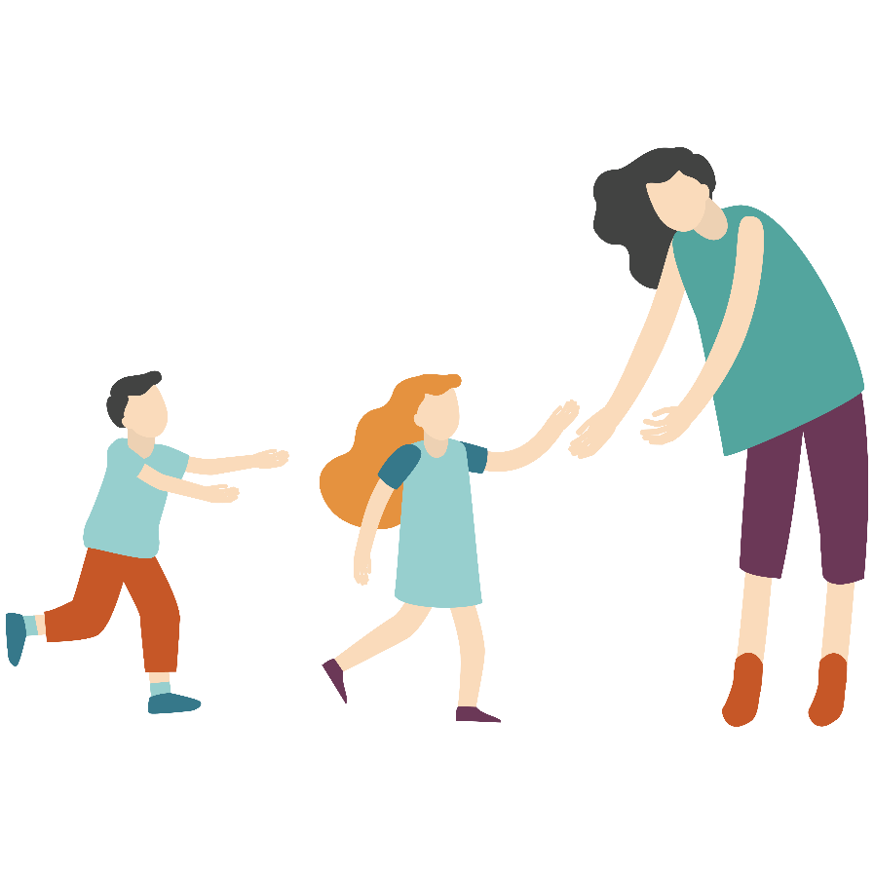
Take a guess!
____________ Number of babies born to teen mothers in the U.S. in 2020.
____________ Percentage that teen birth rates have dropped since 1991.
____________ Number of teen pregnancies in
Tennessee in 2020.
77
158,043
4,826

Slide 19
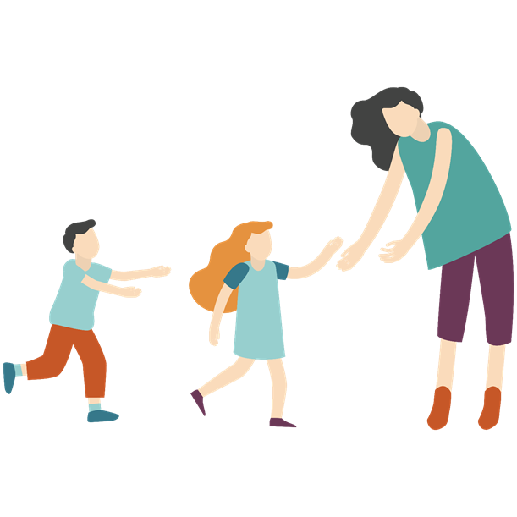
Take a guess!
158,043
____________ Number of babies born to teen mothers in the U.S. in 2020.
____________ Percentage that teen birth rates have dropped since 1991.
____________ Number of teen pregnancies in Tennessee in 2020.
77
4,826
Notes:
The 30-Year Decline in Teen Birth Rates Has Accelerated Since 2010 - Child Trends – ChildTrends
Trends in Teen Pregnancy and Childbearing | HHS Office of Population Affairs

Slide 20
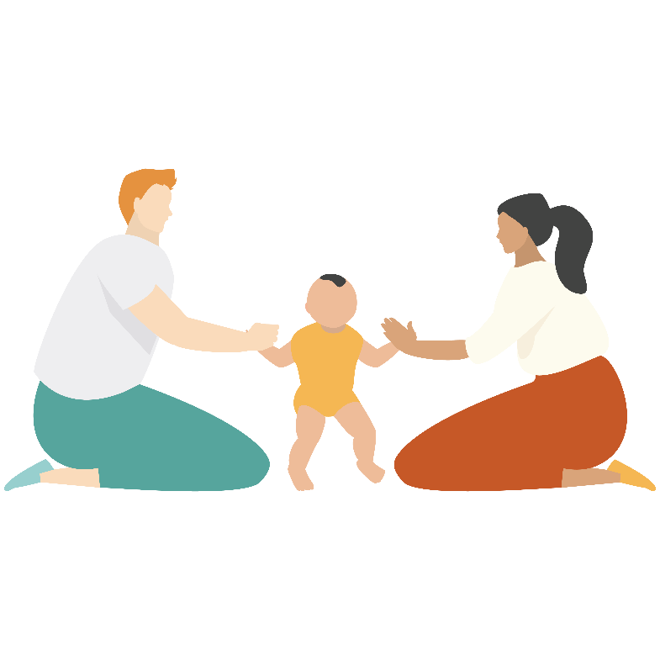
Take a guess!
____________ The percent of teen girls who have a baby before the age of 18 that obtain their high school diploma before the age of 22.
____________ The percent of teen mothers who finish college before the age of 30.
____________ The percent of working teen dads that
get their high school diploma before the age of 26.
40
<2
61

Slide 21
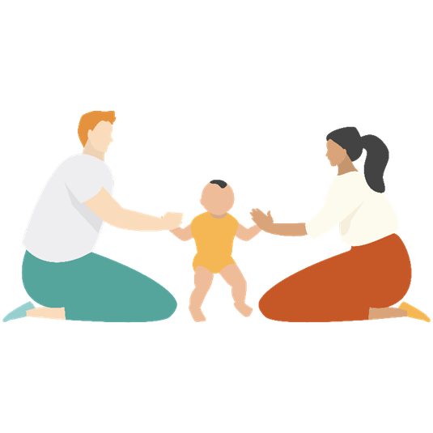
Take a guess!
40
____________ The percent of teen girls who have a baby before the age of 18 that obtain their high school diploma before the age of 22.
____________ The percent of teen mothers who finish college before the age of 30.
____________ The percent of working teen dads that get their high school diploma before the age of 26.
<2
61
Notes:
Teen Pregnancy Prevention (ncsl.org)
Exploring Variation in Teenage Mothers’ and Fathers’ Educational Attainment - PMC (nih.gov)

Slide 22
For more information visit:
www.Centerstone.org/teen

