Slide 1

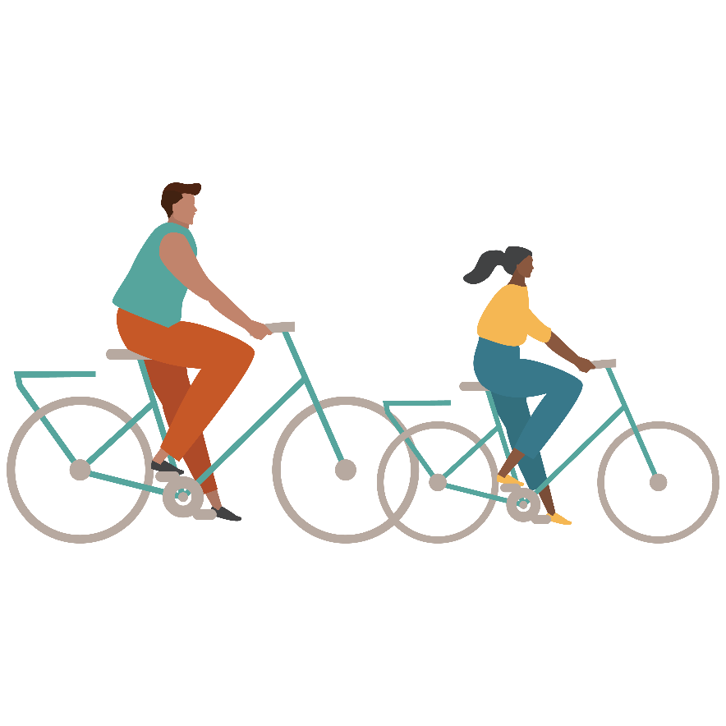
Puberty and Human Reproduction
Tool Kit 3.0
This publication was made possible by Grant Number TP1AH000081-01-01 from the Department of Health and Human Services, Office of Population Affairs; its contents are solely the responsibility of the authors and do not necessarily represent the official views of the Department of Health and Human Services.

Slide 2

Everyone goes through puberty…
Puberty typically begins between the ages of 9 and 16.
Everyone goes through puberty and all the changes a body goes through are NORMAL.
This is when a body is transitioning from a child into an adult and the body is then capable of reproducing (producing children).
Notes:
Puberty is the time in a person’s life where their body transitions from the body of a child to the body of an adult. These changes usually start to happen between the ages of 9 and 16, and continue over several years. There are a lot of changes that happen to the body and the brain. This is the time in every person’s life where their body grows and changes more rapidly than any other time.
Many of these changes make it possible for a person with a penis and a person with a vagina to reproduce or make a baby.
Puberty is something that everybody goes through. And although there are a lot of changes that happen, it is completely normal!

Slide 3
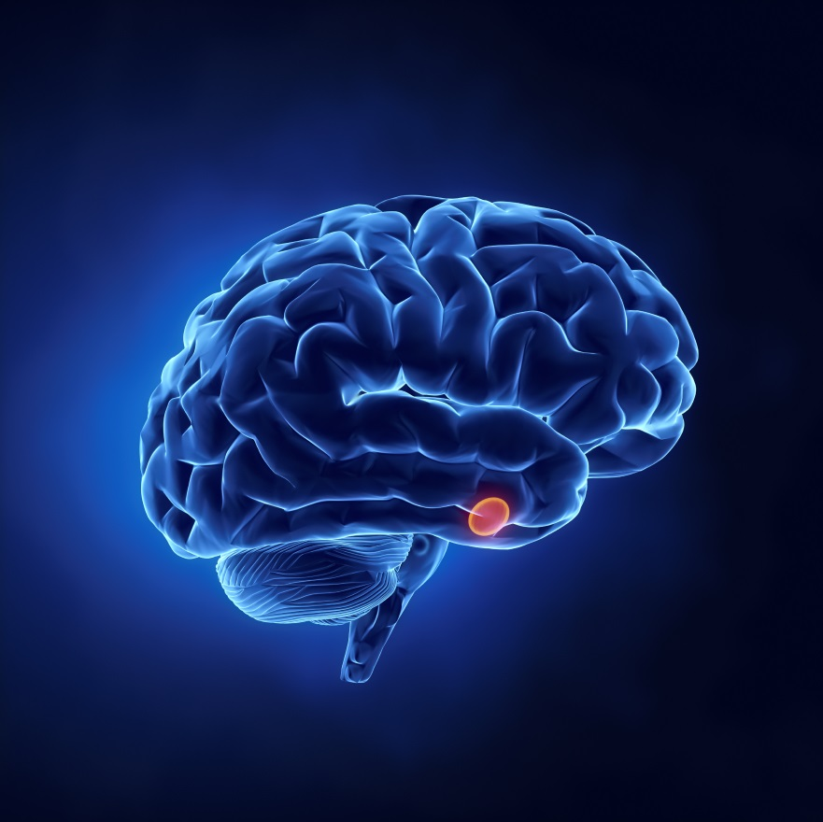
What are hormones?
A chemical in the body that plays a role in development, reproduction, and sexual growth.
Everyone is born with hormones.
The pituitary gland sends signals with hormones. The hormones in control of sexual growth are called sex hormones.
They:
  Determine biological sex (internal and external genitals)
  Change your body from head to toe during puberty
  Help to create sperm, menstruation, and pregnancy
Pituitary gland
Notes:
The changes that happen to the body and brain during puberty are caused by hormones. Hormones are chemicals in the body, that play a role in development, reproduction, and sexual growth. Everyone is born with hormones.
The pituitary gland sends signals with hormones. The hormones in control of sexual growth are called sex hormones.
Hormones have a lot of responsibility! They determine our biological sex, so what genitals we are born with, they change the body from head to toe during puberty, and help to create sperm, menstruation, and pregnancy (which are all things we’ll talk about in a moment).

Slide 4

Puberty –Biological Males
The pituitary gland sends a signal to the testicles to start producing the male sex hormone: testosterone
Release of testosterone signals the body to start puberty!
  Genitals grow and develop and erections occur, which is when blood fills the spongy tissue of the penis and makes it hard.
The testicles begin to make semen, which is a white liquid that comes out of the tip of the penis during ejaculation (typically from excitement during erection).
Each ejaculation can contain 15-400+ million sperm.
Biological males start making sperm during puberty.
  It takes about 64 days to make sperm, but it’s always being made so it never runs out!
Notes:
In biological males (a person with a penis), the pituitary gland sends a signal to the testicles to start producing the male sex hormone: testosterone.
Release of testosterone signals the body to start puberty!
Another change that is caused by the release of testosterone is the development of the testicles and the creation of sperm. The testicles will grow larger and fuller during puberty and will start to create sperm for the first time. Sperm are male sex cells and once the testicles start producing sperm, they are continuously being made. The full process of making sperm takes about 64 days, but they are always being made so they never run out.
At some point, a person will start experiencing erections. This is when the spongy tissue of the penis fills with blood and gets hard and sticks out from the body. During an erection someone might experience ejaculation, which is when a white liquid called semen comes out of the tip of the penis (typically from excitement). Semen is the fluid that carries sperm out of the penis.
FUN FACT: Each ejaculation of semen can contain 200-400 million sperm.
So once a male starts creating sperm, they are then capable of reproducing if their sperm is met with a biological female’s egg, which usually happens through sexual intercourse. We’ll talk more about this later.

Slide 5
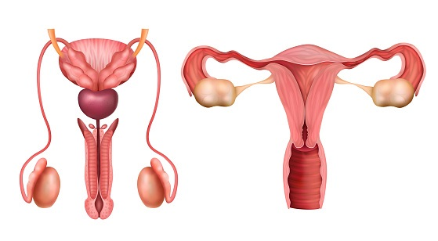
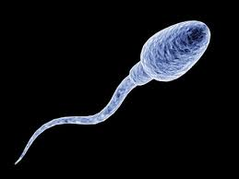
Internal Anatomy- Semen Formation
Testicles make sperm
Sperm travel from testicles to epididymis
  Finish developing
From epididymis to vas deferens
Seminal vesicles and prostate
  Both make fluids to form semen
  Semen=fluids + sperm
vas deferens
Seminal vesicles
prostate
epididymis
Magnified sperm cell
testicles
Notes:
The epididymis, vas deferens, prostate, and seminal vesicles make up the internal anatomy. Together they produce semen. Semen is made from body fluids and sperm.
Sperm are made in the testicles. It takes approximately 64 days to make sperm and the body is always making them. From there, they move into the epididymis and finish developing. During a process called ejaculation, sperm will move from the epididymis through the vas deferens. The seminal vesicles and prostate gland produce seminal fluids, which mixes with sperm to form semen.
When ejaculation occurs, semen leaves the tip of the penis. There can be hundreds of million sperm in each ejaculate. Prior to ejaculation, a fluid called pre-ejaculatory fluid, or “pre-cum,” is produced by the Cowper’s gland* and discharged from the penis to clear out any urine that may remain in the urethra. This fluid can sometimes contain sperm, though not as much as in semen.
Facilitator Note: The Cowper’s gland*, or bulbourethral glands, are equivalent to the Bartholin glands discussed later- both secrete a lubricating fluid.
I know that was a lot of information. Does anyone have any questions over the productive anatomy and function of a person with a penis before we move on?

Slide 6
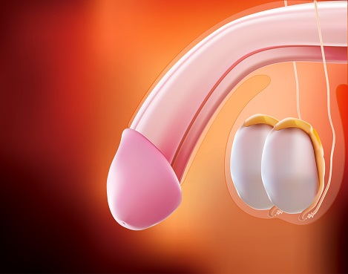

External Anatomy-penis
Scrotum protects testicles
Testicles produce testosterone and make sperm
Glans is tip of shaft
  full of nerve endings
  opening of urethra
  urine or semen exit
Penis is the shaft
  contains urethra
Diagram of circumcised penis
penis
urethra
scrotum
glans
Urethral opening
testicles
Notes:
The penis, scrotum, and testicles make up the external anatomy. The scrotum is the muscular sack that holds the testicles to protect them and keep their temperature regulated. The average length of an erect penis ranges from 5.1 to 5.5 inches.
We already learned what the testicles do. Who remembers? (Pause for responses; produce testosterone and make sperm) Click slide to reveal answer.
The penis is made up of the shaft and glans. The glans is the tip of the penis and is full of nerve endings. The shaft is the main part that contains the urethra.
The urethral opening is on the glans. This is where urine and semen leave the body but not at the same time. When the penis is erect, there is a muscle that contracts and closes off the bladder. Think of a door that opens and closes.

Slide 7

Puberty – Biological Females
The pituitary gland sends a signal to the ovaries to start producing the female sex hormone, estrogen!
Other hormones such as progesterone and some testosterone are produced.
Release of estrogen signals the body to begin
puberty.
Pituitary gland
Notes:
In biological females (person with a uterus), the pituitary gland sends a signal to the ovaries to start producing the female sex hormone: estrogen. The female body also produces some progesterone and testosterone.

Slide 8
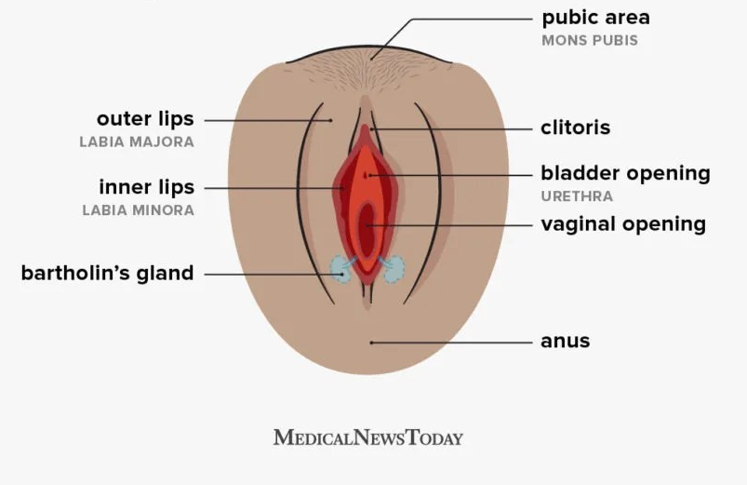
External Anatomy- Vulva
Vulva has many parts.
Mons Pubis protects pubic bone.
Clitoris has thousands of nerve endings.
Labia are folds of skin surrounding the vaginal opening.
Urethral opening is where urine exits the body.
Vaginal opening is where period blood and vaginal childbirth leave the body.
Bartholin’s glands produce fluid to keep vagina lubricated
Design by Diego Sabogal
Notes:
The external reproductive anatomy for a person with a uterus is called the vulva. Many people confuse this with the vagina thinking the two terms mean the same thing. The vaginal opening is actually only one part of the vulva.
The vulva is made up of many parts. The mons pubis (pubic mound/area) is the fleshy part covered by pubic hair after puberty. It protects the pubic bone.
The clitoris is made of the same tissue as the penis that fills with blood during arousal. It also contains thousands of nerve endings that play a role in human arousal.
The labia are folds of skin that surround the vaginal opening. The Labia Majora are the outer folds (lips) and the Labia Minora are the inner folds (lips). Just like with the penis, the shape, size, color, etc. of the labia will vary from person to person as every body is different.
The urethral opening is where urine comes out.
The vaginal opening is where the period exits the body. The vaginal opening is also where vaginal sex takes place. If someone has a baby that is delivered vaginally, this is also where the baby exits the body.
The Bartholin’s glands are located internally on either side of the vaginal opening. They secrete fluid that helps lubricate the vagina.
The anus is the opening where stool leaves the body. The anus is not part of the reproductive system, but it is located nearby.
Are there any questions about the external anatomy or its functions?
Image: https://www.theguardian.com/lifeandstyle/2021/may/30/most-britons-cannot-name-parts-vulva-survey

Slide 9
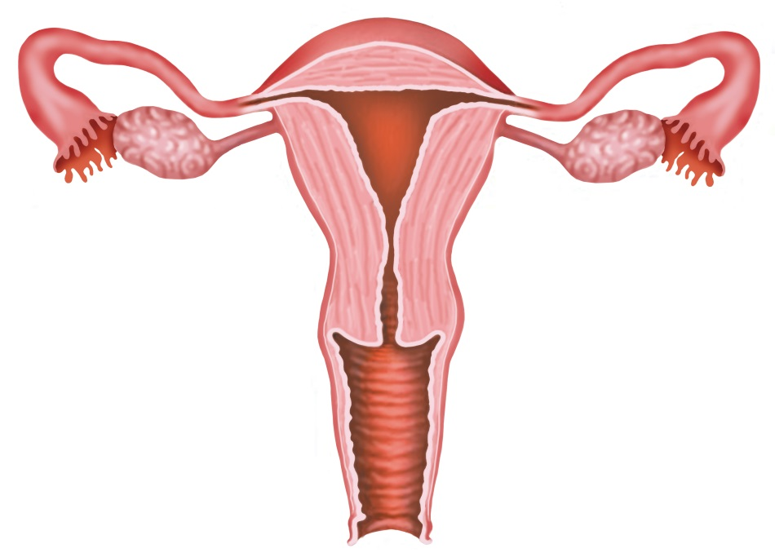
Internal Female Anatomy
Fallopian Tube
Ovary
Uterus
Cervix (opening to uterus)
Vaginal Canal
Vagina
Notes:
The vagina is a canal that runs from the vaginal opening to the cervix. The average vaginal canal is about 3.5 inches deep. The vaginal canal is made of a muscular wall that can stretch to allow a baby to pass through during childbirth and then return to it’s normal size. It will also expand during arousal.
The cervix is the opening of the uterus which is also called the womb.
The cervix produces cervical mucus. The color, consistency, and texture change throughout the cycle. During ovulation, cervical mucus increases due to the large increase in estrogen. Cervical mucus mixes with the Bartholin’s glands fluid to create vaginal discharge. These natural secretions are normal and help regulate the vaginal pH balance. This is one way the body keeps the vagina healthy!
On either side of the uterus are the ovaries and the fallopian tubes. You will learn more about their functions in the video we will watch next.

Slide 10
Ovulation
During puberty, ovulation process occurs for the first time.
This is when an egg is released from one of the ovaries.
The egg (ovum) travels into the fallopian tube and waits for sperm for 12 to 24 hours to create a possible pregnancy together.
The uterine lining will thicken to support the possible pregnancy.
Interesting fact: The body doesn’t constantly create eggs. The number of eggs a person has, is what they were born with.
Notes:
During puberty, a person with a vagina will ovulate for the first time. This is when an egg, or ovum, is released from one of the ovaries. The egg then travels into the fallopian tube and waits for the possibility of meeting with a sperm.
During ovulation, the uterus is also creating a thickened lining of nutrients that is used to support a pregnancy if it happens. The process of ovulation happens about once a month around 14 days before someone starts their period.

Slide 11
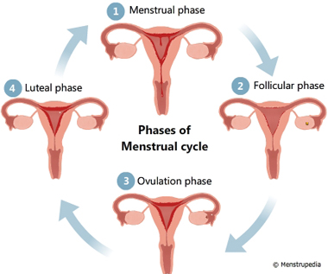
Menstruation Cycle
Notes:
Here is an illustrated example of the menstrual cycle, showing the process of what we just discussed. The following video will explain more about what happens during menstruation.
https://www.menstrupedia.com/articles/girls/cycle-phases

Slide 12
When the released egg does not meet with a sperm…
Watch “Menstruation: What to Expect”
Notes:
Video linked: https://youtu.be/DBe7-PHRav8

Slide 13

Periods can be confusing . . .
When menstruation begins, periods can be irregular.
Examples of this can include:
Having a period one month and not having a period the next month
Having a period that lasts three days then having one that last seven days
Having a heavy menstrual flow one month and having a light menstrual flow the next month
There may also be occasional light bleeding between periods, sometimes called spotting.
Most cycles regulate in one to two years. If you are concerned about any aspect of your cycle, contact your doctor.
Notes:
When menstruation begins, periods can be irregular.
Examples of this can include:
Having a period one month and not having a period the next month
Having a period that lasts three days then having one that last seven days
Having a heavy menstrual flow one month and having a light menstrual flow the next month
There may also be occasional light bleeding between periods, sometimes called spotting.
Most cycles regulate in one to two years. If you are concerned about any aspect of your cycle, contact your doctor.

Slide 14
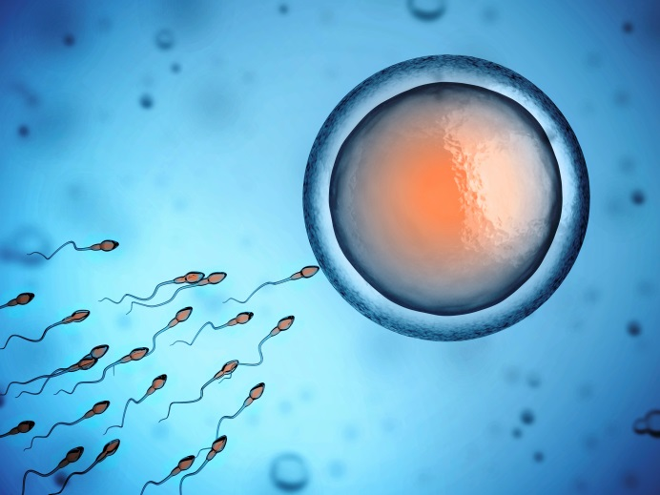
What if sperm meets with an egg?
If a sperm meets with the egg cell the egg is now fertilized, and a pregnancy can occur.
The fertilized egg drops into the uterus, implants in the thickened lining, and begins to grow.
Important fact: Sperm can live in the uterus/fallopian tubes for up to FIVE days, so even if someone hasn’t ovulated yet, it is possible for sperm to still be present when they do.
Notes:
If a sperm meets with the egg cell, the egg is now fertilized and a pregnancy can occur.
The fertilized egg drops into the uterus, implants in the thickened lining, and begins to grow.
Important fact: Sperm can live in a person’s body for up to FIVE days, so even if a someone hasn’t ovulated yet, it is possible for sperm to still be present when they do (which can result in a pregnancy).

Slide 15
Watch “Pregnancy and Reproduction Explained”
Notes:
Video Linked: https://youtu.be/OejdOS4IqeE
Here’s a quick video that explains reproduction a little more in depth.

Slide 16



Interesting Facts
Ovaries are about the size of large strawberries.
Fallopian tubes are the size of drinking straws.
The uterus is the size of a pear
...until pregnancy when it can grow to be as large as a watermelon!
Notes:
To give you a better idea about the size of this anatomy:
Ovaries are about the size of large strawberries.
Fallopian tubes are the size of drinking straws.
The uterus is the size of a pear
…..until pregnancy when it can grow to be as large as a watermelon!

Slide 17

During puberty, people begin experiencing some emotional changes as well….

Slide 18
Watch: “Puberty: Feeling Depressed, Happy and Other Emotions”
Notes:
Video Linked: https://youtu.be/mAPLTaRM48Y
Let’s learn about some of the emotional feelings people can experience during puberty.

Slide 19

Sexual Feelings During Puberty
During puberty, many young people begin experiencing sexual feelings.
These feelings can cause physical reactions
  Sweaty palms
  Nervous stomach
  Faster heartbeat
  Erections
  A tingly feeling in the genitals
They can also cause emotional reactions
  Love and attraction, heartbreak, impulsive or obsessive
  feelings and/or behaviors
Notes:
During puberty, many young people begin experiencing sexual feelings. This is totally normal and healthy.
These feelings can cause physical and also emotional reactions. Hormones are influencing these feelings and behaviors, so it is difficult for teens to control these reactions.

Slide 20
Sexual Feelings During Puberty
All of these reactions are completely NORMAL.
It is also normal to not feel sexual feelings during this time.
These feelings can be strong and confusing. It’s what you do about them that’s important! Sometimes young people act on these feelings without thinking things through.
The safest thing to do is to take time to get to know and understand your body and your feelings before you jump in to anything.
You do not have to ACT on your sexual feelings just because you are having them!
Notes:
All of these reactions are completely NORMAL.
However, It is also normal to not feel sexual feelings during this time.
These feelings can be strong and confusing. It’s what you do about them that’s important! Sometimes young people act on these feelings without thinking things through.
The safest thing to do is to take time to get to know and understand your body and your feelings before you jump in to anything.
You do not have to ACT on your sexual feelings just because you are having them!

Slide 21

For more information and resources
Visit centerstone.org/teen
Notes:
That’s all for this first lesson!
Any Questions?

Slide 22
Sources
“Making A Difference!” Select Media
http://kidshealth.org/kid/grow/body_stuff/puberty.html
http://www.cdc.gov/ncbddd/childdevelopment/positiveparenting/adolescence.html
AMAZE. (2017, December 07). Pregnancy and Reproduction Explained. Retrieved from https://youtu.be/OejdOS4IqeE?list=PLwKLUKhFLWhYoU638Q_oJz4SVOuhQT8JH
AMAZE. (2018, May 10). Puberty: Feeling Depressed, Happy and Other Emotions. Retrieved from https://youtu.be/mAPLTaRM48Y
AMAZE. (2018, July 23). Menstruation: What to Expect. Retrieved from https://youtu.be/DBe7-PHRav8

