Slide 1
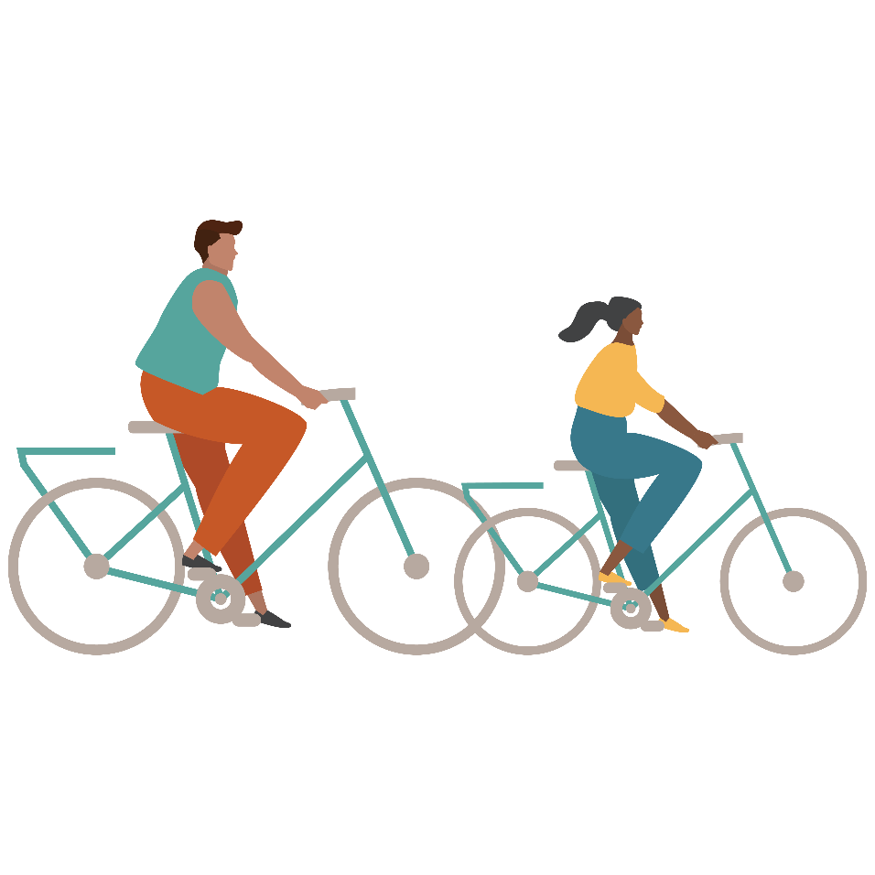
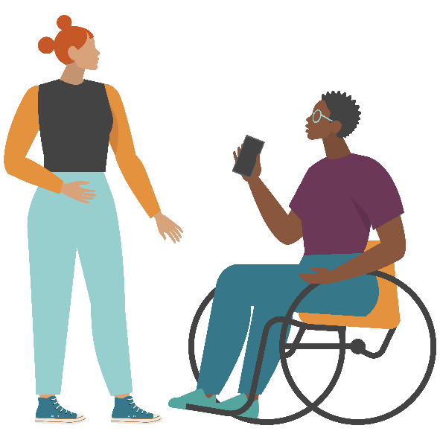
Refusal Skills
Teen Sexual Health Toolkit 3.0
This publication was made possible by Grant Number TP1AH000081-01-01 from the Department of Health and Human Services, Office of Population Affairs; its contents are solely the responsibility of the authors and do not necessarily represent the official views of the Department of Health and Human Services.
Notes:
Facilitator note: This presentation includes information around sex and condom usage. Always review your state/county’s policies around these topics before presenting in schools.

Slide 2
What is Peer/Partner Pressure?
Sometimes, our friends or the person we are dating may pressure us to do things we don’t feel comfortable with.
What are some examples of things our friends might pressure us about?
What are some examples of things our dating partner might pressure us about?

Slide 3
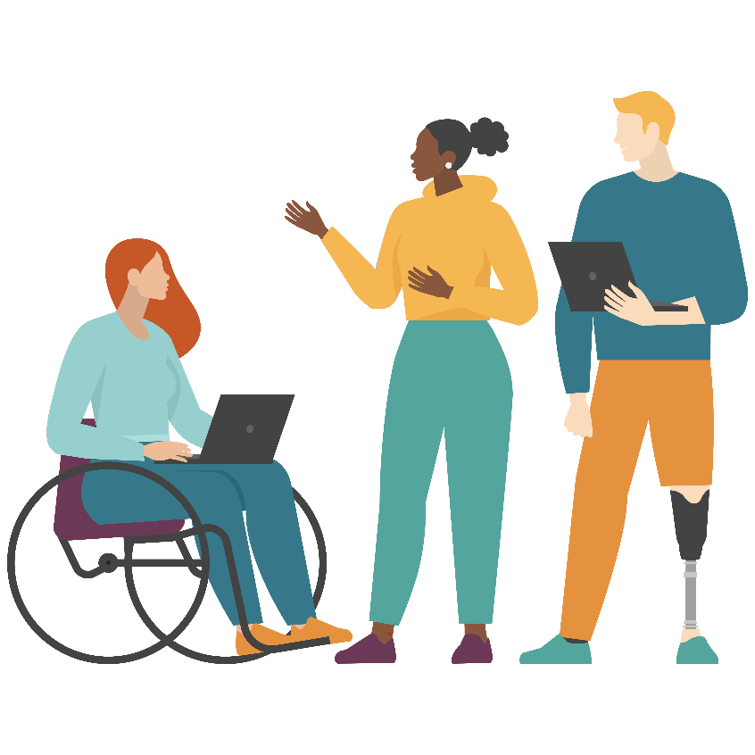
Refusal Skills
If you are in a situation where someone pressures you to do something that you do not want to do, how might you respond?
It is important that we have a plan for how we want to respond in high-pressure situations.
Refusal skills take practice!
The next few slides will help us better understand how we can respond.
Notes:
Update: Refusal skills are defined as the skills that a person needs to develop to resist peer pressure and avoid risky situations.

Slide 4
Stop and Say “No!”
STOP – It’s a good idea to STOP when you start to feel uncomfortable. If you STOP, you have time to take a deep breath and think clearly about what is happening.
STOPPING is a good first step towards an effective conversation.
SAY NO – Don’t assume your friend/partner can read your mind. You need to say NO and say it like you mean it. Don’t laugh, send mixed signals or pretend like it’s “no big deal”.
Your friend/partner should respect you as soon as you STOP and SAY NO. If they continue to pressure you, you have every right to leave.
Notes:
“No” can also be ‘said’ nonverbally by using body language such as moving your body away from the person, crossing your arms, shaking your head, or by facial expressions (ex. frowning).

Slide 5
Give a Reason Why
WHY – After you say NO you can be prepared to give your partner a reason WHY. Some examples might be:
I’m just not ready.
I’m not ready to be a parent.
I don’t want to worry about getting in trouble.
I won’t be able to get home on time.
I want to wait.
REMEMBER – It’s always ok to just simply say, “I don’t want to!” That is enough of a reason and your partner should respect it!

Slide 6
Give a Reason Why You Want to Wait to Be Safe
WAIT – If you’ve decided it is best for you to WAIT, be clear about your decision. Your decisions should always be respected.
You might discuss how long you want to wait and what your boundaries are. (Ex. “I want to have sex, but I’m only willing to do so if we use a condom.” or “I want to wait until we’ve gotten to know each other better.”)

Slide 7
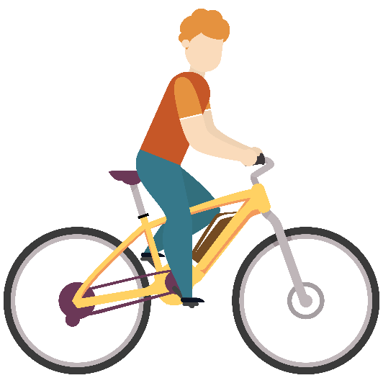
Avoid the Situation
AVOID –If you are not ready or do not want to, it is always best to AVOID the situation by setting boundaries. Avoid secluded places or places you feel uncomfortable, plan to hang outside the bedroom, or in groups of friends.
Avoiding situations that make you uncomfortable may keep you safer and prevent you from having a conversation, interaction (or possible confrontation) you didn’t want or weren’t ready for in the first place.

Slide 8
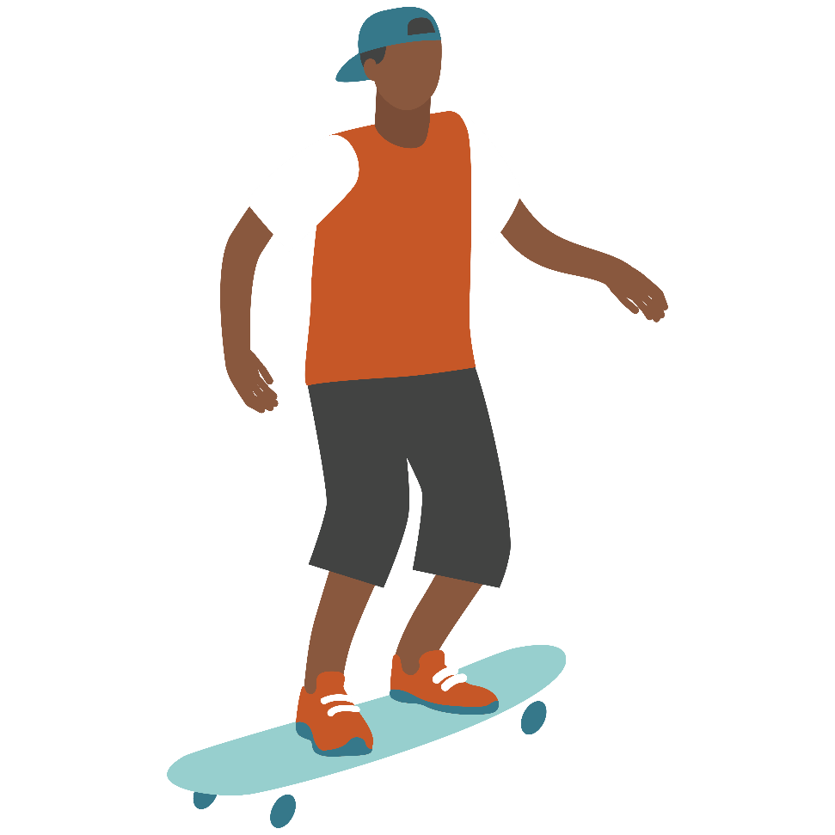
Offer Alternatives
ALTERNATIVES – to show your partner you care about them suggest some ALTERNATIVES. Some examples might be:
Let’s go to the movies.
Let’s go play video games.
Let’s go for a walk.
- Let’s just hold hands.
Notes:
If you are talking about risk reduction, if they don’t have a condom but still want to be physical, have them give ideas of other things they can do that are less risky activities (kissing, body rubbing, touching, etc) This is also a good way for them to communicate their boundaries.

Slide 9
Get Out of an Unsafe Situation
GET OUT – If you find that the situation you are in is becoming unsafe be prepared to leave.
If your partner is not respecting your feelings, continues to pressure you or is becoming angry or violent, you should GET OUT as quickly and safely as possible. Call for help if you need to. Your boundaries should ALWAYS be respected.
Notes:
If the situation is taking place at your home where you’re not able to leave, you may ask/demand that your partner leaves instead. If the situation escalates further, then finding another safe place to go (ex. Friend’s house, police department, etc.) might be the best option

Slide 10
Go Do Something Fun
Talking about boundaries can be awkward! If your partner is being respectful of your boundaries then you can GO do something fun afterwards. This can help you both feel better about the conversation while strengthening your relationship.

Slide 11
S - Stop and Say No
W - Give a reason Why you want to Wait to be safe (or WHY you don’t want to)
A -Avoid the situation and offer Alternatives
G - Get out of an unsafe situation or Go do something fun

Slide 12
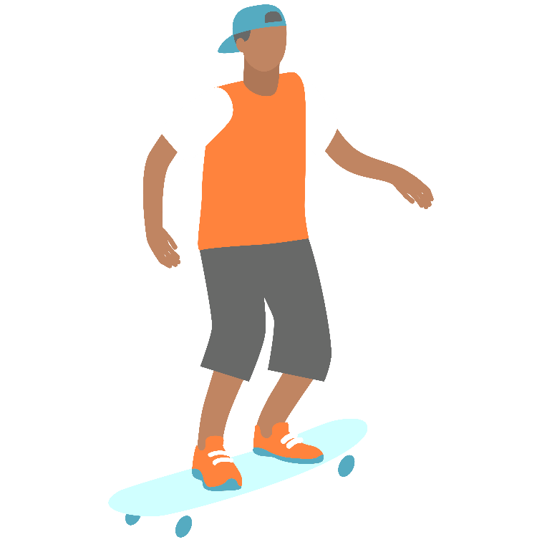
If you get into a high pressure situation, just remember:
SWAG

Slide 13
Using SWAG in non-sexual situations
Remember – you can use SWAG to negotiate out of
any high pressure/risky scenario, not just sex.
You can use SWAG to say no to drinking, drugs, smoking, skipping school, or anything!

Slide 14
SWAG Examples
Stop and Say No
-No, I don’t want to have sex!
-No, I won’t have sex without a condom!
-No, I mean it. I do not want to do this!
-Stop pressuring me, I said no!
Why You Want to Wait
-I’m not ready to handle the responsibility that
comes with sex.
-I don’t want to have sex without a condom.
-I just don’t want to have sex.
I don’t want an STI, we need to get tested first.
Avoid the Situation
-I don’t want to be in the bedroom with the
door closed.
-We should get condoms so that we are prepared!
Offer Alternatives
-Let’s go to a movie.
-Let’s get something to eat.
-Let’s just kiss since we don’t have a condom.
Get Out (unsafe/pressure continues)
-I’m leaving because you aren’t respecting my decision.
-If you don’t stop pressuring me I’m going to break up with you!
Go do something Fun! (safe/respectful)
-Thank you for respecting me. I love you! Do you want to go out?
-I know this conversation was hard. Let’s go to the mall and hang out for awhile.
Notes:
Facilitator note: Suggesting alternatives that include sexual acts or condom usage is not permitted in TN schools per Family Life laws. Please review before presenting.

Slide 15
For more information visit:
www.Centerstone.org/teen

