Slide 1
Teen Sexual Health Tool Kit 3.0
Sexually Transmitted Infections
This publication was made possible by Grant Number TP1AH000252 from the Department of Health and Human Services, Office of Population Affairs; its contents are solely the responsibility of the authors and do not necessarily represent the official views of the Department of Health and Human Services.

Slide 2
STI
What do the letters S.T.I. stand for?
Sexually
Transmitted
Infections
You may hear the term STD used instead of STI. STD stands for Sexually Transmitted Disease. They essentially mean the same thing. Infection is just a little more accurate.

Slide 3
What are the names of some STIs?
Chlamydia
Gonorrhea
Syphilis
Trichomoniasis
Human Papillomavirus (HPV)
Herpes
HIV
Hepatitis B
Pubic Lice
Notes:
This is a list of the most common STIs

Slide 4
Categorizing STIs
Bacterial
With a Cure
Syphilis
Viral
Without a Cure
HIV
Parasitic
With a Cure
Trichomoniasis
Gonorrhea
Chlamydia
Herpes
Hepatitis B
HPV
Pubic Lice

Slide 5
Symptoms of STIs
Can include:
Abnormal discharge and/or bleeding from the genitals or infected body part
Pain, fever, swelling and tenderness
Frequent urination, itching and burning in the infected area
Warts, bumps, rashes and oozing sores which can be itchy, sore or painful
Most of the time, there are no symptoms at all!

Slide 6
No Symptoms?
The majority of people who contract an STI will never experience symptoms or will experience symptoms so mild that they go unnoticed.
You cannot tell just by looking at a person whether or not they have an STI. While external symptoms are possible, every person’s body responds to STIs differently.
This is important because even if a person is not having symptoms, STIs can still be causing damage to their reproductive system!
The only way to know you have an STI is to get tested!

Slide 7
How can someone contract an STI?
STIs are primarily spread through:
Vaginal, anal and oral sex
Other ways STIs can be transmitted:
From mother to child during pregnancy or child birth
Blood contact (through needles or syringes)
Skin to skin contact with the infected body part. (This does not include HIV! )

Slide 8
HIV- The Facts
HIV stands for Human Immunodeficiency Virus.
HIV is a virus that can be sexually transmitted.
When a person becomes infected with HIV, their white blood cell count is reduced and their immune system is compromised.
This means that the individual can become sick very easily.
If left untreated, HIV can develop into AIDS which stands for Acquired Immune Deficiency Syndrome.
HIV is the virus that causes AIDS. A person cannot have AIDS without having first contracted HIV.

Slide 9
HIV- The Facts
HIV can be transmitted through the following bodily fluids:
Blood
Semen
Vaginal fluids
Anal fluids
Breast Milk
This means that not only can HIV be transmitted through vaginal, anal and oral sex, but it can also be transmitted through childbirth, breastfeeding or by sharing needles of any kind.

Slide 10
HIV- The Facts
When a person contracts HIV, their body begins to produce a specific type of antibody.
HIV is not contained in saliva (meaning HIV cannot be transmitted through kissing!). However, HIV antibodies can be found in saliva. The oral rapid test is a simple mouth swab that tests for HIV antibodies.
It can take up to three months after a person contracts HIV for their antibody count to be elevated enough to show up on a test. This means individuals participating in higher risk activities should be getting tested every three to six months.
Notes:
HIV tests can be an oral or blood test

Slide 11
Who can get an STI?
Anyone can get an STI.
They are infections that are spread primarily through sexual contact.
Teens and young people are affected by STIs more than any other age group.
According to the CDC, half of the 26 million new STI cases each year occur in youth ages 15 to 24.
Notes:
https://www.cdc.gov/std/life-stages-populations/adolescents-youngadults.htm

Slide 12
How can a person avoid getting an STI?
Not engaging in sexual activity that puts them at risk.
This includes vaginal, anal and oral sex.
The use of condoms and dental dams can help prevent the spread of STIs.
This includes latex, polyurethane or polyisoprene external condoms, as well as nitrile internal condoms.
Lambskin condoms are NOT effective in preventing the spread of STIs.
Pre Exposure Prophylaxis (PrEP)- a pill that can be taken to help prevent the transmission of HIV*
Notes:
Facilitator notes:
Dental dams are made of latex, come in many different flavors and are used for oral sex on a vulva or anus.
*More info about PrEP: https://www.cdc.gov/hiv/basics/prep.html access for youth may differ depending on state and location.

Slide 13
Let’s Review!
We know how STIs are transmitted.
We know the signs and symptoms of an STI infection.
We know some STIs don’t have symptoms.
We know how to avoid getting an STI.
But why would we want to avoid getting an STI?
Let’s brainstorm some of the potential long-term physical and emotional complications of contracting an STI.

Slide 14
Potential Long-term Physical Complications if STI is Left Untreated
Death (AIDS, syphilis, Hep B, and HPV related cancer)
Blindness (syphilis)
Paralysis (syphilis)
Heart disease (syphilis)
Brain damage (syphilis)
Cervical, vaginal, penile, anal or throat cancers (HPV)
Infertility (gonorrhea and chlamydia)
Ectopic pregnancy (gonorrhea and chlamydia)
Pelvic inflammatory disease (gonorrhea and chlamydia)
Chronic pelvic pain (gonorrhea and chlamydia)
Liver damage (Hep B)
Notes:
Facilitator notes:
An ectopic pregnancy occurs when a fertilized egg remains in the fallopian tube instead of moving into the uterus. The condition can be life threatening and most frequently results in loss of pregnancy.
Most complications are a result of untreated STIs.

Slide 15
Potential Emotional Complications
Sad
Angry
Confused
Embarrassed
Afraid
Depressed
Anyone engaging in sexual behaviors can be at risk for contracting an STI.
It does not mean they are “dirty” or a bad person.
If someone experiences any of these emotions because of an STI diagnosis, it doesn’t mean that they should feel ashamed or embarrassed. It’s normal to have emotional reactions, especially when there is so much stigma and shame around STIs. We don’t want to shame anyone that contracts an STI, we want to encourage them to get tested and avoid risky behaviors in the future.

Slide 16
Testing and Treatment
Treatment requires the care of a medical professional.
Bacterial STIs can typically be detected in the urine or by taking a swab of the infected area. In some cases a blood test is used.
Gonorrhea and chlamydia infections in the throat or rectum can only be tested and diagnosed with a throat or rectal swab.
Treatment with antibiotics will cure a bacterial STI*
Parasitic STIs can be cured with pills and/or topical medications
Notes:
*EXCEPTION – Antibiotic Resistant Gonorrhea may not treatable with antibiotics.
https://www.cdc.gov/std/gonorrhea/drug-resistant/default.htm

Slide 17
Testing and Treatment
Viral STIs are not curable. There are medications to make the symptoms more manageable.
Human Papilloma Virus (HPV) and Hepatitis B both have preventative vaccinations that can help the body develop immunities. You can talk to your physician, or visit your local health department, to learn more about these vaccinations.
Free or reduce cost testing and treatment are available at your local health department.
Make sure to ask about which STIs they test

Slide 18
Human Papillomavirus (HPV) Facts
There are many types of Human Papillomavirus
HPV is the most common STI. Almost all sexually active adults will contract HPV in their lifetime.
HPV can be transmitted through skin to skin contact.
For most people, HPV will clear up on its own within about two years.
For some individuals, HPV can develop into cancer or genital warts. About 50% of infections are high-risk (cancer causing).
The HPV vaccine can prevent the majority of cancer causing viral strains
HPV can only be detected by testing cervical cells, this is done during a pap smear.* There is not currently a test for those with a penis.*
Notes:
https://www.cdc.gov/std/hpv/stdfact-hpv.htm
*Pap smears are typically done starting at age 21. Cervical cancer screening start at age 30 (if pap tests have been normal).
*No test for those assigned male at birth, but all genders are encouraged to get the HPV vaccine (at age 9-12)

Slide 19
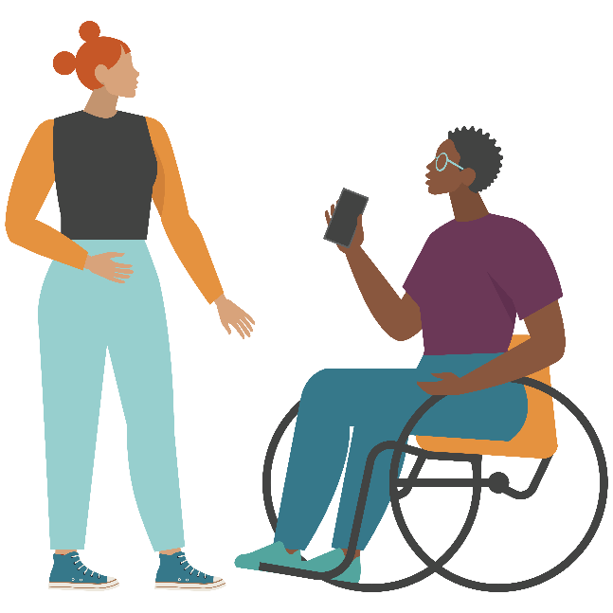
How can I prevent the spread of STIs?
Getting tested, and having all of your partners get tested, will help reduce your risk of STIs including HIV.
Getting tested at least once a year is recommended. If you know your status, you can get treated early if needed.
Condoms and/or dental dams can also help reduce the risk of STIs including HIV (along with PrEP for HIV).
Not engaging in sexual activity is the only 100% effective way to prevent the spread of STIs.*
Notes:
*some STIs (HPV, Herpes, Syphilis, public lice) can be passed through skin to skin contact- without penetration and/or fluid exchange.
HIV can be contracted through sharing needles.

Slide 20
In Closing…
You now know the basic information that
will help you avoid getting an STI.
Remember how STIs are transmitted, how to reduce your chance of contracting an STI, what can happen if you get infected and how to get tested.
You can also avoid STIs by abstaining from behaviors that put you at risk.

Slide 21
For more information visit
Centerstoneteen.org

