Slide 1
Social Media and Safety
Teen Sexual Health Toolkit 2.0
This publication was made possible by Grant Number TP1AH000081-01-01 from the Department of Health and Human Services, Office of Population Affairs; its contents are solely the responsibility of the authors and do not necessarily represent the official views of the Department of Health and Human Services.

Slide 2
Social Media
“forms of electronic communication through which users create online communities to share information, ideas, personal messages and other content.” – Merriam Webster
Modern social media is a relatively new invention.
Launched in
2005
Launched in 2010
Launched in 2011
Launched in 2016
Notes:
YouTube
Instagram
Snapchat
Tik Tok

Slide 3
Almost everyone uses the internet/social media for information, entertainment and to connect with friends and family….
…but it is important to understand the risks of being online and how to stay safe.
Notes:
Social Media and Internet have many benefits like:
finding and learning new information
learning about different people, perspectives and cultures
connecting with others
expressing yourself and what you are passionate about
spreading positive messages
At the same time, there are many risks and potential dangers on social media.

Slide 4
Let’s talk about risks…why should you be careful?

Slide 5
Internet/Social Media Addiction
How many of you have access to a device?
A smart phone or iPad/tablet?
A laptop or PC?
A gaming device with internet access?
How many of you check your phone/device :
When you wake up?
When you’re at school?
When you’re with family or friends?
When you’re supposed to be sleeping?

Slide 6
Internet/Social Media Addiction
In 2018, 750 teens were surveyed about their internet and social media usage:
45% said they are online almost constantly
97% said they use social media such as Instagram, Snapchat or YouTube.
Heavy usage can:
Result in lower grades
Lead to stress and offline relationship problems
Increase feelings of loneliness, depression, and anxiety
An increase in procrastination and less focus
Promotes the spread of unreliable/false information
Notes:
https://www.pewinternet.org/2018/11/28/teens-social-media-habits-and-experiences/

Slide 7
Information Sharing
Online, how many of you have posted. . .
A photo of yourself?
Your interests?
Your school name?
The town/city in which you live?
Your email address?
Your phone number?
Your relationship status?
A video of you?
Notes:
This might not seem like a big deal, but it is not safe to share your personal information on such a public platform where anyone can have access to it.
Do not share your address, phone number, email address, or school name online or on social media.
Be very careful when sharing thoughts, photos and videos of yourself.
- Anyone could have access to it – even those you do not want to see it.
Photo: https://www.wsj.com/articles/coping-with-photo-overload-on-social-media-1502720991

Slide 8
Social Media is Like a Giant Bulletin Board
When you post something to a site/app, you are posting it on THEIR bulletin board.
Be aware of the “Terms of Service” you agree to when using an app.
The site/app you posted to may have the right to take and use your content for their benefit.

Slide 9
What you post can impact your future:
25% of college admission staff search an applicant’s digital footprints.
70% of hiring managers search digital footprints during their hiring process.
Can’t I just delete it?
When something is posted online, we can’t say it is truly gone even after deleting it. Posts, images, videos and texts can remain on servers forever.
Notes:
Because social media is SO common, it has now become a common way people and professionals learn about someone – from googling them to finding their social media accounts.
It might seem like common sense not to post anything inappropriate for everyone to see, but it’s easier than you may think.
So, having good grades and a high test score may not be everything it takes to be accepted into the school of your dreams.
Digital Footprint – the information about a particular person that exists on the Internet as a result of their online activity
https://www.usnews.com/education/best-colleges/articles/2019-08-22/why-colleges-look-at-students-social-media-accounts
http://www.nytimes.com/2013/11/10/business/they-loved-your-gpa-then-they-saw-your-tweets.html?mcubz=0
https://studybreaks.com/culture/what-you-post-online-social-media/
https://www.careerbuilder.com/advice/social-media-survey-2017

Slide 10
They didn’t hire people who posted…
inappropriate pics, videos or information
information about them drinking or using drugs
discrimination (race, gender, religion, orientation, etc.)
linked to criminal behavior
unprofessional screen name
lied about an absence
slandered previous employer or co-workers
Notes:
http://www.careerbuilder.com/share/aboutus/pressreleasesdetail.aspx?ed=12%2F31%2F2016&id=pr945&sd=4%2F28%2F2016

Slide 11
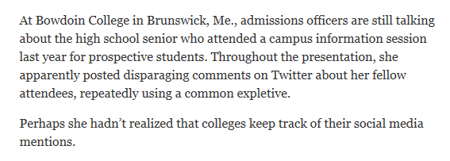
Notes:
http://bleacherreport.com/articles/2146596-penn-state-ol-coach-herb-hand-drops-recruit-over-social-media-actions?utm_source=twitter.com&utm_medium=referral&utm_campaign=programming-national
http://www.nydailynews.com/news/crime/teen-jailed-making-lol-crack-facebook-car-crash-drunk-driving-article-1.1162283
http://www.nytimes.com/2013/11/10/business/they-loved-your-gpa-then-they-saw-your-tweets.html?mcubz=0
http://www.kptv.com/story/35174857/longview-teen-arrested-after-social-media-school-shooting-threat
https://www.click2houston.com/news/texas/girl-13-arrested-in-connection-with-social-media-threats-in-splendora

Slide 12
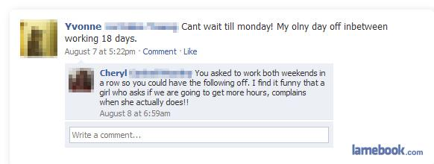
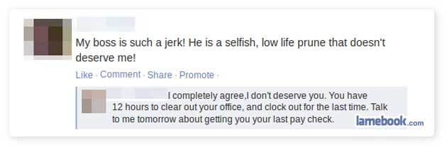
Notes:
Even if you got the job or you’re already on the team, you still need to be mindful.

Slide 13
Cyberbullying
A form of bullying that occurs through technology, such
as by phone or social media
Making threats
Spreading rumors
Verbal attacks
Excluding someone on purpose
Cyberbullying is different from traditional bullying because:
It happens 24 hours a day, 7 days a week.
It can be anonymous and be seen by a lot of people.
It’s hard to stop or take back once it’s started.
Notes:
https://www.healthyplace.com/suicide/bullying-cyberbullying-and-teen-suicide

Slide 14
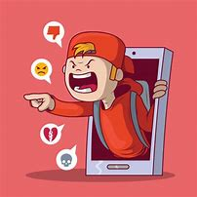
Forms of Cyberbullying
Flaming – Online fights, name calling, etc.
Disparaging – posts or messages that target someone.
Exclusion – Leaving someone out of a game or group chat.
Outing – Sharing someone’s secrets or private information.
Trickery – Tricking someone telling you something private and then outing them.
Impersonation – also known as Catfishing/being a Catfish
Harassment – Repeatedly sending malicious messages.
Cyberstalking – Continuously harassing and disparaging including threats of physical harm.

Slide 15
A Growing Problem…
59% of teens say they have been bullied or harassed online.
87% say they have seen cyberbullying occur online.
70% admitted to being the cyberbully at some point.
Notes:
This includes social media AND online gaming.
87% of 4,972 teens
70% of 10,000 teens
https://www.pewinternet.org/2018/09/27/a-majority-of-teens-have-experienced-some-form-of-cyberbullying/
https://www.broadbandsearch.net/blog/cyber-bullying-statistics
https://www.digitaltrends.com/social-media/cyberbullying-statistics-2017-ditch-the-label/

Slide 16
CONTENT WARNING: The next couple of slides will be discussing suicide as it relates to cyberbullying.

Slide 17
Notes:
Students that had been cyberbullied where asked to identify what issues they felt arose because of their experience with cyberbullying.
https://www.broadbandsearch.net/blog/cyber-bullying-statistics#post-navigation-0

Slide 18
Cyberbullying and Suicide
Online abuse and suicidal thoughts are directly interconnected.
Bullying behavior (both by the bully and target) is linked to suicidal behavior (attempts, ideations or completions).
A study in Britain found that at least half of suicides among young people are related to bullying.
Notes:
More on bullying:
- Suicide is the third leading cause of death among young people.
- Nearly 30% of students are either bullies or victims of bullying.
- 160,000 kids stay home from school every day because of fear of bullying.
http://www.bullyingstatistics.org/content/bullying-and-suicide.html
https://techjury.net/stats-about/cyberbullying/

Slide 19
Channing Smith, 16
Audrie Taylor Pott, 15
Carla Jamerson, 14
Phoebe Prince, 15
Jessica Logan, 18
Amanda Todd, 15
Kenneth Weishuhn, 14
Tyler Clementi, 18
Ashawnty Davis, 10
Nigel Shelby, 15
Allem Halkic, 17
Joshua Unsworth, 15
Rebecca Sedwick, 12
Megan Meier, 13
Notes:
Sadly, all of these young people died by suicide, which was influenced by bullying.
https://en.wikipedia.org/wiki/Suicide_of_Tyler_Clementi
https://nobullying.com/jessica-logan/
https://en.wikipedia.org/wiki/Suicide_of_Phoebe_Prince
https://en.wikipedia.org/wiki/Suicide_of_Amanda_Todd
https://www.reviewjournal.com/local/local-las-vegas/abuse-investigation-was-ongoing-when-las-vegas-teen-took-her-life/
http://www.cnn.com/2014/04/18/living/rebecca-sedwick-bullying-suicide-follow-parents/index.html
https://www.meganmeierfoundation.org/megans-story.html
https://en.wikipedia.org/wiki/Kenneth_Weishuhn
http://www.dailymail.co.uk/news/article-2305332/Joshua-Unsworth-15-bullied-death-trolls-internet.html
http://www.heraldsun.com.au/news/victoria/west-gate-bridge-suicide-case-dad-sues-vicroads-over-son-allem-halkics-death/news-story/000ce00c8bcd38527195c3de6e63857e

Slide 20
If you or someone you know struggles with thoughts about suicide call the National Suicide Prevention Lifeline at 1-800-273-8255 for help and support.

Slide 21
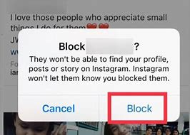
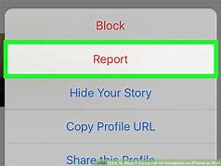
What If I’m Being Bullied Online?
Being bullied might make you feel scared or helpless, or that there is nothing you can do to make it stop. But that is not true!
Talk to an adult you trust
Ignore and Block
Don’t bully the bully
Stick with your supporters
Report bullying when it happens
Notes:
Talk to an adult you trust
Talking to an adult is not “snitching.” A trusted adult can provide support and help to stop what is happening.
Ignore and Block
Ignore hateful messages and block any harassing accounts, emails or phone numbers.
Don’t bully the bully
Being kind and respectful (even to the bully) shows you are in control of your emotions and you won’t let their negativity bring you down.
Stick with your supporters
Talk about it with friends you can trust and like you for you.
Report bullying when it happens
You can report comments and accounts on the app or website you are using.
Https://www.plannedparenthood.org/learn/teens/bullying-safety-privacy/bullying
https://www.stopbullying.gov/cyberbullying/how-to-deal-with-haters

Slide 22
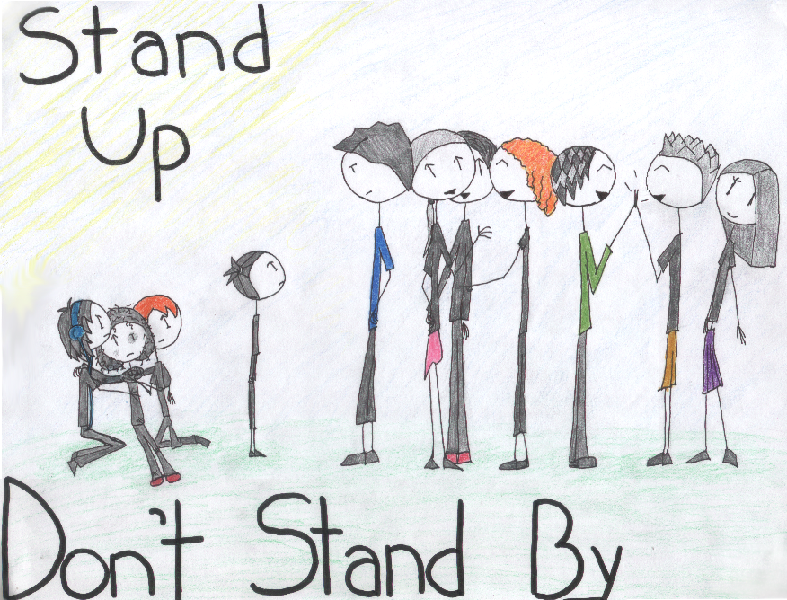
How Can I Help Prevent Cyberbullying?
Never contribute to cyberbullying, even if your friends encourages you to do it.
Don’t encourage bullies by “liking” or sharing their comments or posts.
Don’t spread rumors online. Call out misinformation and gossip.
Don’t forward mean messages.
Defend other people when they’re being bullied online.
Block and report harassers.(More on how to do this later)
Notes:
https://www.plannedparenthood.org/learn/teens/bullying-safety-privacy/bullying/bullying-social-media

Slide 23
Digital Abuse
Similar to cyberbullying.
It is the use of technology (such as texting and social media) to bully, stalk or harass someone, often a dating partner.
Warning Signs
Monitors your friends and followers
Sends you negative, insulting or threatening messages
Uses social media to keep constant tabs on you
Puts you down online
Sends or asks for unwanted, explicit photos or videos
Steals or insists on giving up login info and passwords
Tags you unkindly in photos or posts
Notes:
25% of teens say they have been sent explicit images they didn’t ask for, while 7% say someone has shared explicit images of them without their consent.

Slide 24
Your Digital Relationship Rights
You have the right to be away from your phone or social media without worrying that your partner will get mad.
You do not have to send any pictures or statements that you are uncomfortable sending.
You do not have to share your passwords with anyone that you are dating.
Remember that you lose control of any message you send out.

Slide 25
Catfishing
When a person creates fake personal profiles on social media sites with the intention to deceive, take advantage, and/or lure into an online relationship.
This is also a form of cyberbullying.
Teens are more likely to be victims of catfishing because they more often friend or accept follows from people they do not know.
Notes:
https://medium.com/@taariqmutaliph/catfishing-the-danger-of-youth-352229710bd

Slide 26
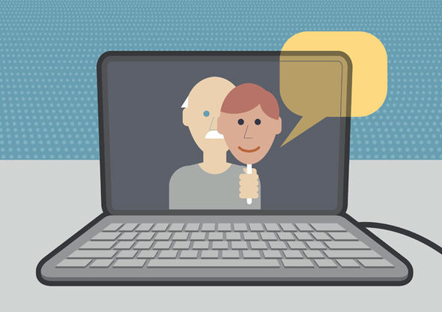
Why Would Someone Catfish?
Embarrassed of their true self
Like the attention that comes from pretending to be someone else older, younger, different gender)
To bully, trick or embarrass someone else.
To gain trust then take advantage of someone.
Notes:
People catfish other for many different reasons.
Teens often friend or accept follows from people they do not know – making teens more susceptible to being catfished.

Slide 27
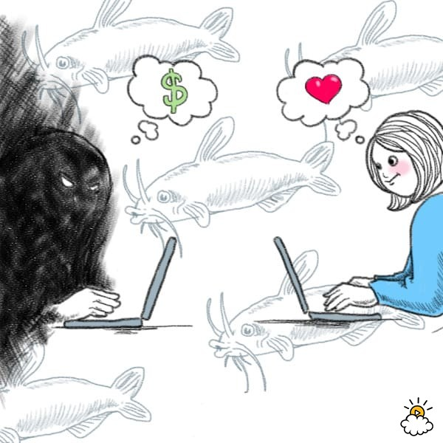
Warning Signs
Refuses to speak on the phone or video chat
Tries to form a strong bond with you as soon as possible
Asks you for $$$$$$
All photos appear professionally done
Too many or too few internet friends
Travels a lot for work/school, but never in your area
Avoids in-person contact/always makes excuses
Notes:
If you suspect someone is catfishing you:
Do not share any of your personal information.
Consider ending communication with them.
Never meet up with them alone.

Slide 28
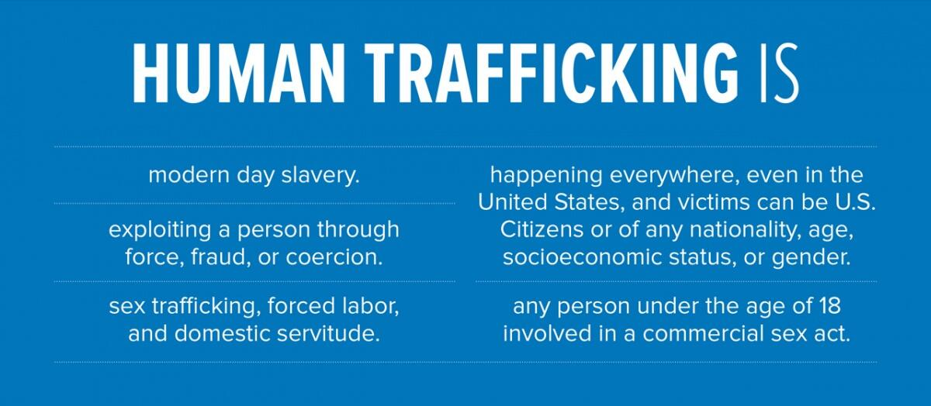
Human Trafficking is a dangerous and serious risk of social media to be aware of…
“Human trafficking is the business of stealing freedom for profit. In some cases, traffickers trick, defraud or physically force victims into selling sex. In others, victims are lied to, assaulted, threatened or manipulated into working under inhumane, illegal or otherwise unacceptable conditions.”
Perpetrators may use social media to start a friendship or relationship with someone to gain their trust. Once trust is established, they may use the relationship to convince them into going somewhere and/or meeting.
They do this by pretending:
To offer friendship and understanding
To be in love
To offer housing
To offer a job or opportunity such as modeling or acting
In reality they plan on selling them into modern day slavery for the purposes of sex, labor, and/or becoming a servant.
Notes:
https://www.dhs.gov/blue-campaign/infographic
https://polarisproject.org/human-trafficking-and-social-media/

Slide 29
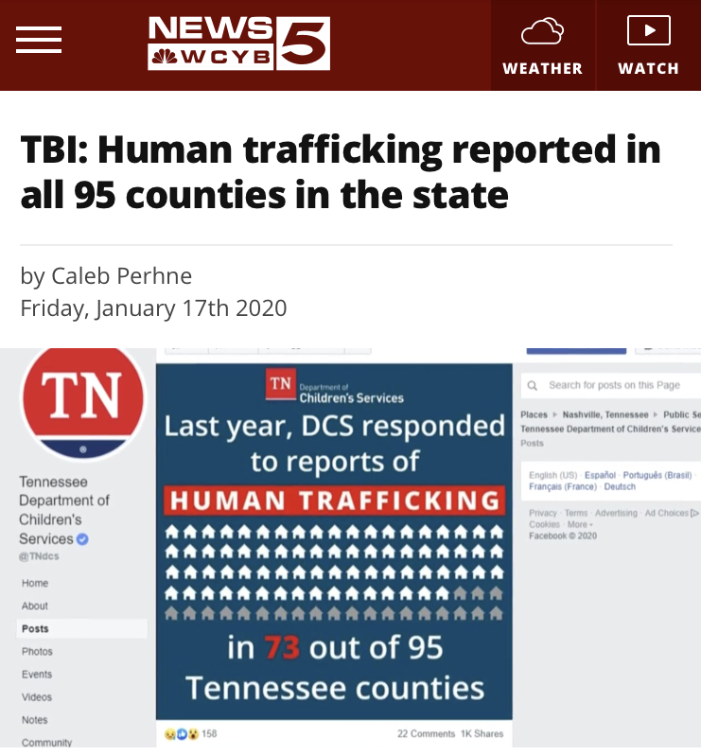
YES, human trafficking happens everywhere, including Tennessee.
But could that really happen here?
Notes:
In July of 2019 Human Trafficking became the second highest rising crime in TENNESSEE.

Slide 30
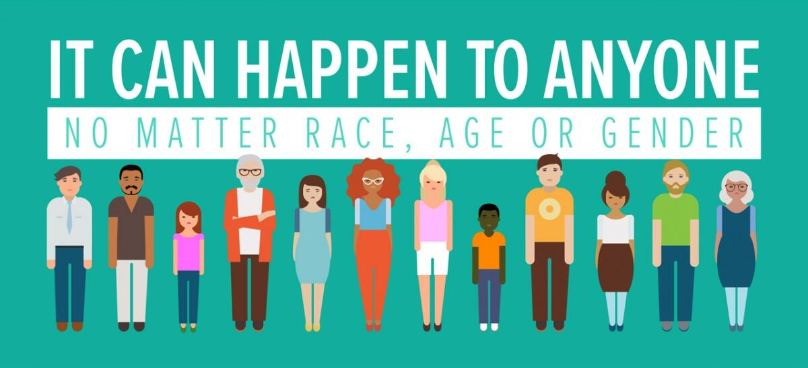
Recent reports in Middle Tennessee
Notes:
October 2019: Rutherford County
https://www.wgnsradio.com/tbi-two-day-operation-arrests16-men-on-seeking-sex-cms-54104
November 2019: Grundy County
https://www.wkrn.com/video/missing-teen-found-in-grundy-county/4139679/
January 2020: Maury County
https://www.wkrn.com/news/crime-tracker/11-men-charged-in-spring-hill-sex-trafficking-operation/
For more information on Human Trafficking please visit: https://www.dhs.gov/blue-campaign/what-human-trafficking

Slide 31
National Human Trafficking Hotline:
Call 1-888-3737-888
Text BEFREE to 233733
Get support | Report a tip| Learn more
Notes:
If you or someone you know is in a dangerous situation, its important to talk to a trusted adult for support and help. Together you can call the Human Trafficking Hotline to get more support, report something and learn more about human trafficking.
https://polarisproject.org/human-trafficking/

Slide 32
How Do I Stay Smart & Safe Online?

Slide 34
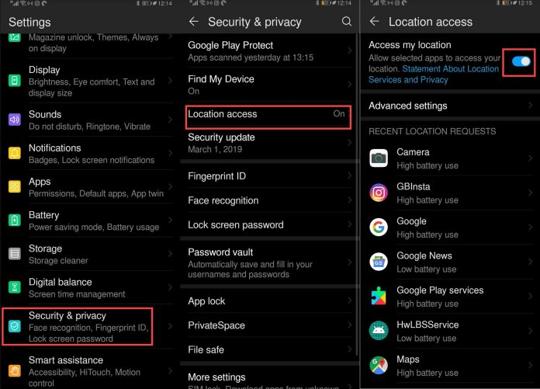
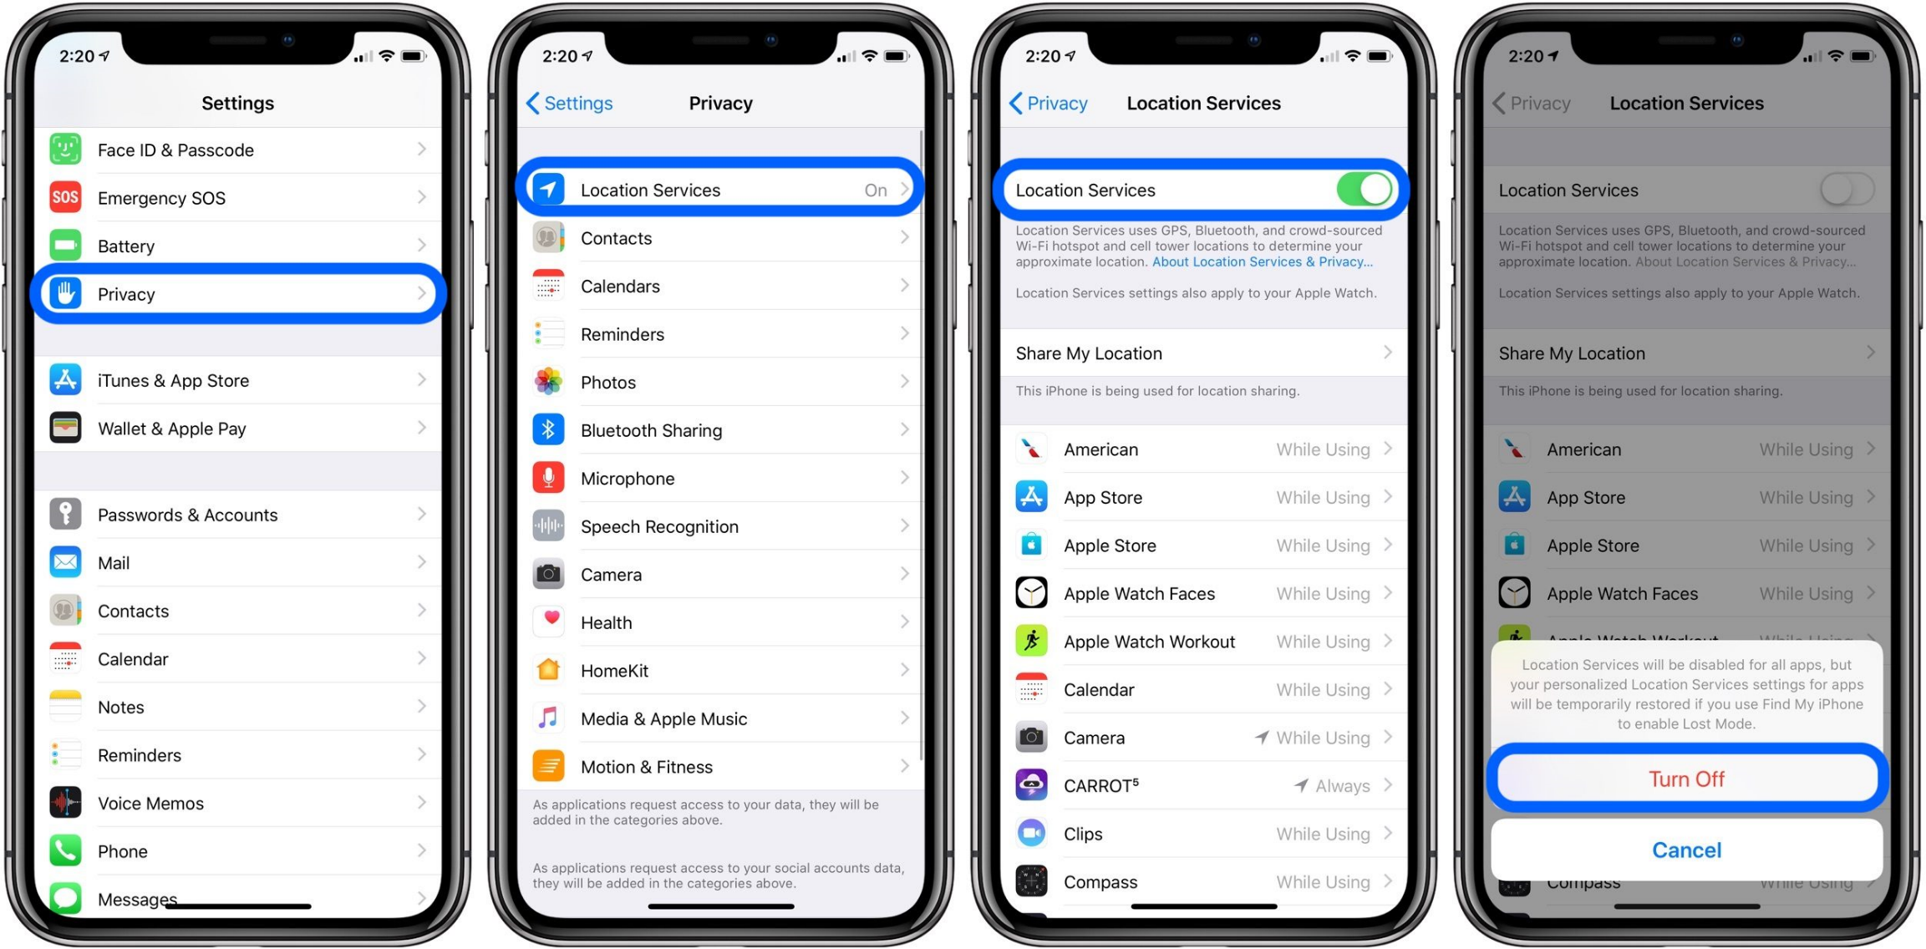
Privacy and Location Settings
Keep your devices locked and password protected.
Be aware of when your phone is using your location:

Slide 35
You Are In Control of Your Settings
Many apps’ default settings allow them access to your location services
If an app is not location-based, then it doesn’t need your location
You can change these settings and choose which apps can use GPS
You can also allow different degrees to which apps can use this information
location ON only while using
turn OFF location
Maps
Weather
Camera
Facebook
Instagram
Twitter
Snapchat
Tik Tok
Safari
Siri
Location-based apps such as Lyft, Fitbit, etc.
Notes:
*Remember to exit out of apps when you are done using, so the app will not continue to use your location!

Slide 36
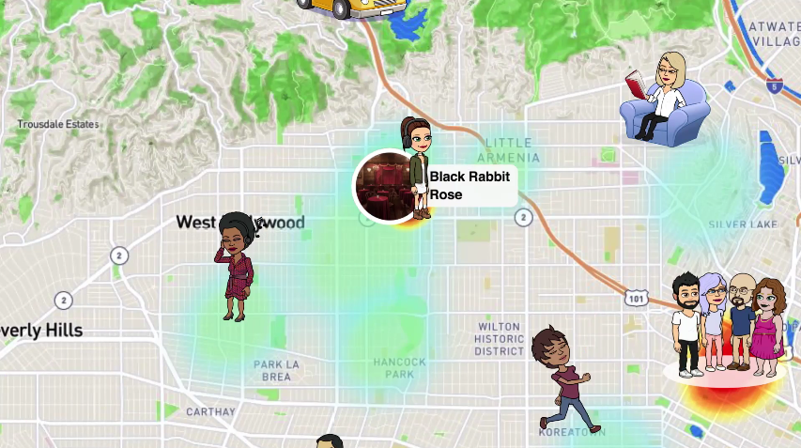
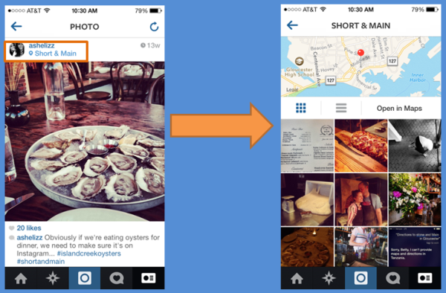
By turning ON location on social media apps, anyone that follows you can see exactly where you are on the map:
Notes:
Snapchat
Instagram

Slide 37
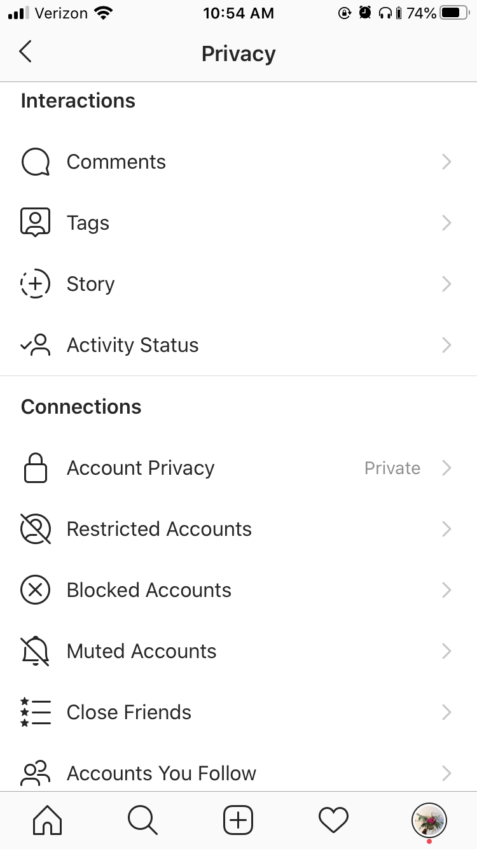
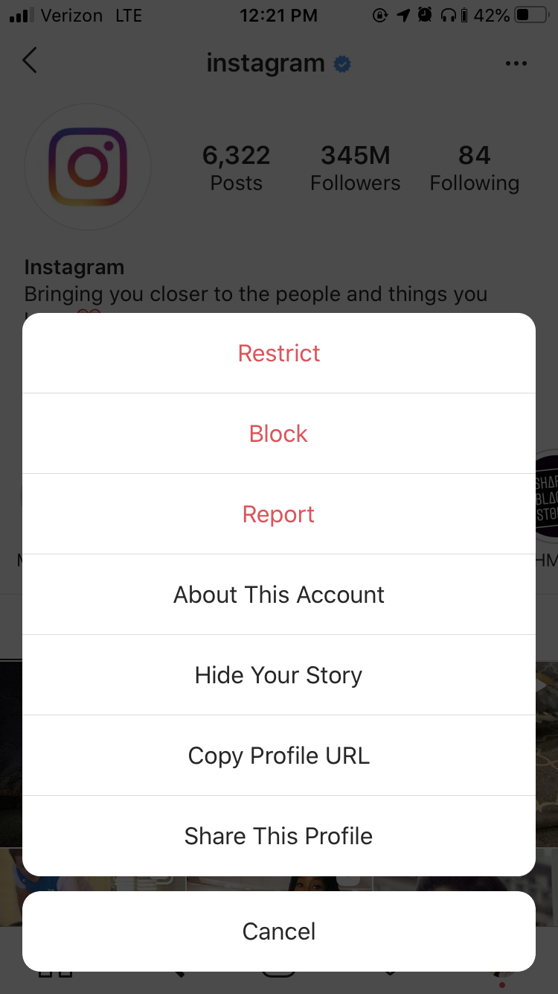
Privacy and Reporting:
Notes:
Go to Settings > Privacy
Comments
Filter who can and cannot comment on your photos and videos
Block inappropriate or offensive words from your comment section
Tags
Filter who has to ask permission to tag you in a post
Untag yourself in posts
Story
Decide who can see your story and mute stories you do not want to see
Activity
Decide who can see when you are active on Instagram
Set your account to Private so only people you approve can see your photos and videos
Restrict accounts to protect yourself from unwanted interactions without having to block or unfollow them. You have to give approval for their comments to show up on your posts.
Block accounts you want zero interaction with.
Reporting - To report an account or comment that includes spam, bullying, harassment, discrimination or is inappropriate go to the account, tap the 3 dots in upper right corner, tap Report and follow prompt.

Slide 38
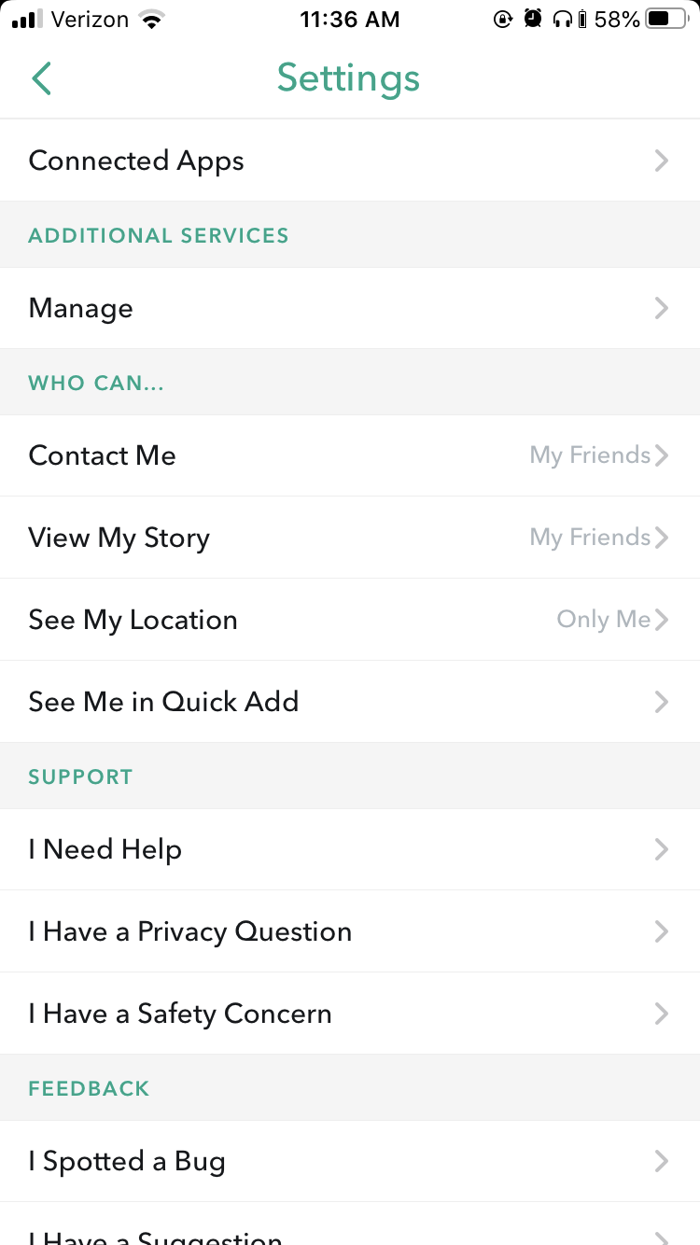
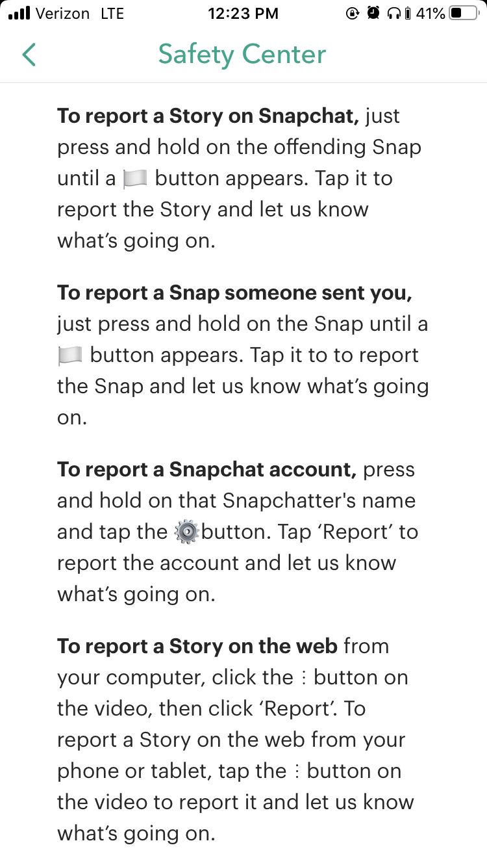
Privacy and Reporting:
Notes:
Contact Me – decide who can message you on Snapchat
View My Story – decide who can view your story
See My Location – decide who can see your location and if you’ll show up on the map
See Me in Quick Add – decide if you want to be suggested for people to add as friend
Reporting – report someone’s story, a snap they sent you, or a snapchat account

Slide 39
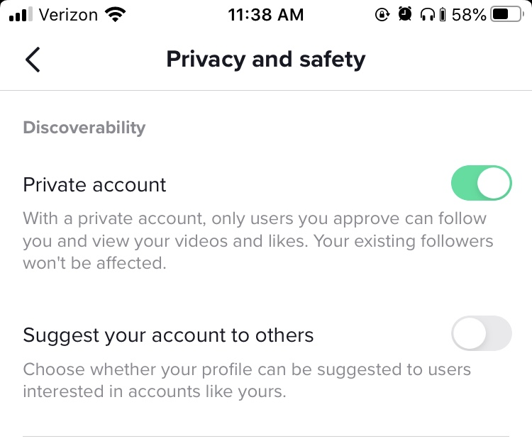
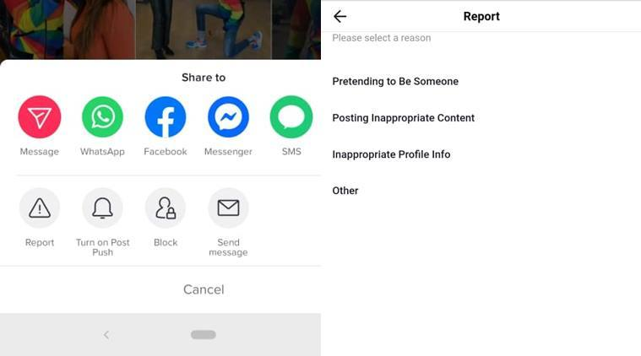
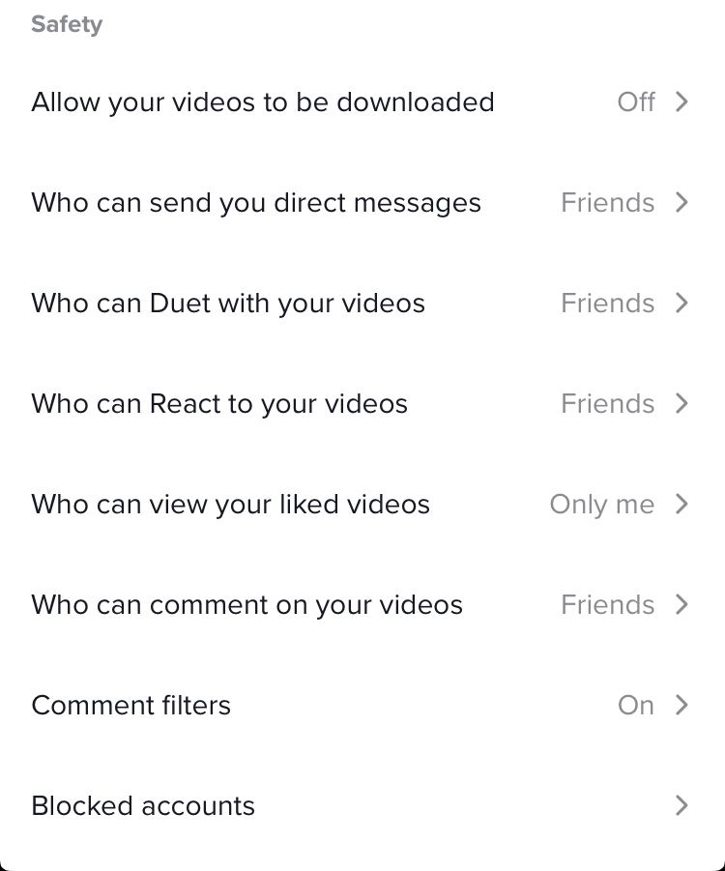
Privacy and Reporting:
Notes:
Go to Profile > 3 dots in upper right corner > Privacy and Safety
Privacy
1. Make account Private so you can approve who can follow you and view your videos
2. Choose if your profile can be suggested for other users to follow
3. Decide if your videos can be downloaded by other users
4. Decide who can duet your videos
5. Decide who can React to your videos
6. Decide who can view videos you’ve liked
7. Decide who can comment on your videos
8. Filter out spam or offensive comments and/or choose specific words you don’t want to see in your comments
Reporting
- Go to user’s account, tap 3 dots in upper right corner, tap Report and follow prompt.

Slide 40
Remember:
Social media is supposed to be a fun place to connect, share creativity etc. Stay smart and keep yourself safe by using your privacy settings to your advantage!
Only report something or someone when you see spam, inappropriateness, discrimination, bullying, harassment and/or abuse. Do not report as a joke, to be funny, or to bully someone.

Slide 41
More ways to be smart about social media…

Slide 42
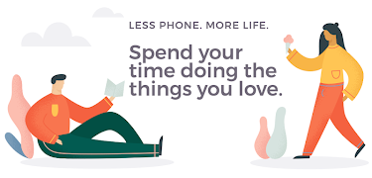
Take A Break!
Spend more time on yourself and what you like, and less time on what others are doing.
Break the cycle of comparing yourself and your life to others.
Remember: Social media is often just a highlight reel of people’s best moments.
Increased ability to focus on your own goals.
Better sleep and healthier habits.
Notes:
Take a break from looking at your phone and/or social media.

Slide 43
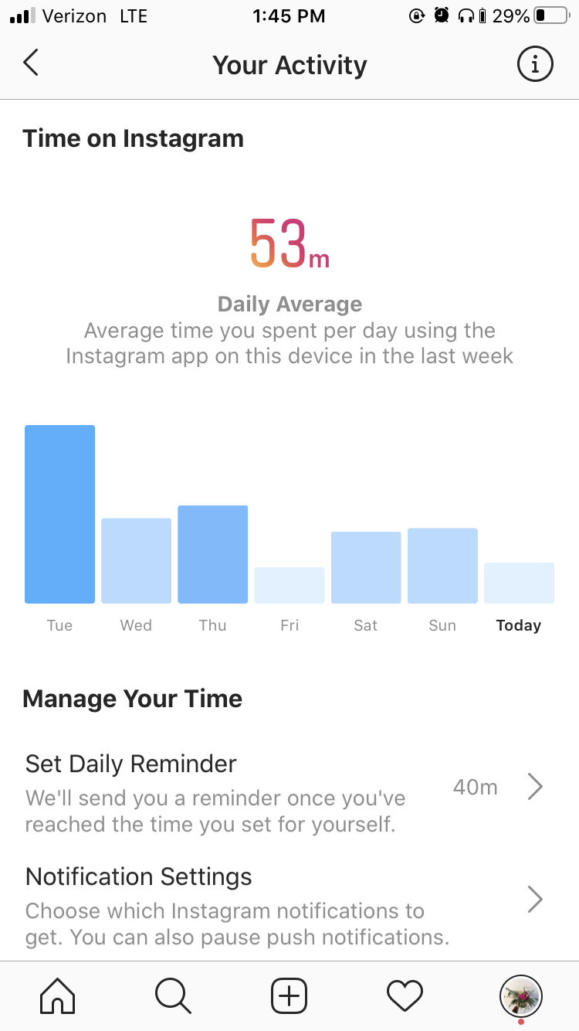
Limit Your Time
Notes:
Instagram: Go to your profile > 3 lines in upper right corner > Your Activity
Track how much time you are scrolling on Instagram each day.
Set a daily limit to your time spent scrolling each day. You will receive a reminder when you’ve reached your limit.
Choose which notifications you want to get. This helps manage how much you are reaching for your phone to check a notification.
TikTok: Your profile > 3 dots in upper right corner > Digital Wellbeing
Set a daily limit for your scrolling time on TikTok. After limit is reached, you will need a password to get in.

Slide 44
Be Smart. Be Safe. Have Fun.

Slide 45
For more information and resources visit:
www.Centerstone.org/teen

