Slide 1
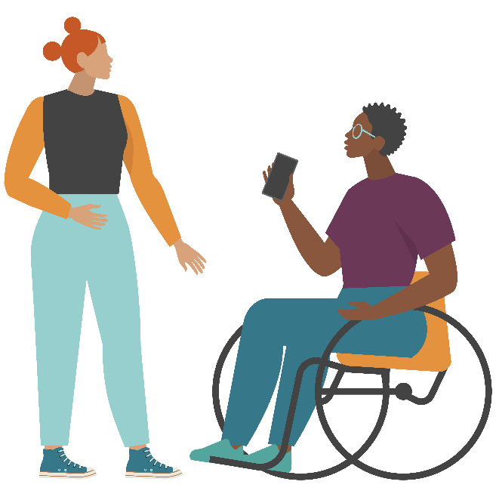
Teen Sexual Health Toolkit 3.0
Social Media Safety
This publication was made possible by Grant Number TP1AH000252 from the Department of Health and Human Services, Office of Population Affairs; its contents are solely the responsibility of the authors and do not necessarily represent the official views of the Department of Health and Human Services.
Notes:
Facilitator note: this presentation is lengthy. You may want to break it up into multiple lessons as it covers several topics.

Slide 2
Social Media
“Forms of electronic communication through which users create online communities to share information, ideas, personal messages and other content.” – Merriam Webster
Modern social media is a relatively new invention.
What are some common/popular social media platforms that young people use?
Launched in
2005
Launched in
2010
Launched in
2011
Launched in
2016
Notes:
*click for each* YouTube, Instagram, Snapchat, and TikTok are the most popular apps for young people (in 2023)
Two-thirds of teens report using TikTok, followed by roughly six-in-ten who say they use Instagram (62%) and Snapchat (59%). Much smaller shares of teens say they have ever used Twitter (23%), Twitch (20%), WhatsApp (17%), Reddit (14%) and Tumblr (5%).
https://www.pewresearch.org/short-reads/2023/04/24/teens-and-social-media-key-findings-from-pew-research-center-surveys/

Slide 3
Benefits and Risks
Almost everyone uses the internet/social media for information, entertainment and to connect with friends and family…but it is important to understand the risks of being online and how to stay safe.
Social Media and Internet have many benefits like:
finding and learning new information
learning about different people, perspectives and cultures
connecting with others
expressing yourself and what you are passionate about
spreading positive messages
Notes:
Majorities of teens report experiencing each of the four positive experiences asked about: feeling more connected to what is going on in their friends’ lives (80%), like they have a place where they can show their creative side (71%), like they have people who can support them through tough times (67%), and that they are more accepted (58%).
https://www.pewresearch.org/short-reads/2023/04/24/teens-and-social-media-key-findings-from-pew-research-center-surveys/

Slide 4
Let’s talk about risks. Why should you be careful online?
Notes:
When it comes to negative experiences, 38% of teens say that what they see on social media makes them feel overwhelmed because of all the drama. Roughly three-in-ten say it makes them feel like their friends are leaving them out of things (31%) or feel pressure to post content that will get lots of comments or likes (29%). And 23% say that what they see on social media makes them feel worse about their own life.
https://www.pewresearch.org/short-reads/2023/04/24/teens-and-social-media-key-findings-from-pew-research-center-surveys/

Slide 5
Internet/Social Media Addiction
How many of you have access to a device?
A smart phone or iPad/tablet?
A laptop or PC?
A gaming device with internet access?
How many of you check your phone/device :
When you wake up?
When you’re at school?
When you’re with family or friends?
When you’re supposed to be sleeping?
Notes:
Teens are relatively divided over whether it would be hard or easy for them to give up social media. Some 54% say it would be very or somewhat hard, while 46% say it would be very or somewhat easy.
https://www.pewresearch.org/short-reads/2023/04/24/teens-and-social-media-key-findings-from-pew-research-center-surveys/

Slide 6
Internet/Social Media Addiction
In 2022, 1,316 teens were surveyed about their internet and social media usage:
97% said they use social media such as Instagram, Snapchat or YouTube and over 70% use these apps daily.
19% said they are on YouTube almost constantly
Heavy usage can:
Result in lower grades
Lead to stress and offline relationship problems
Increase feelings of loneliness, depression, and anxiety
An increase in procrastination and less focus
Promotes the spread of unreliable/false information
Notes:
About a third of teens (36%) say they spend too much time on social media.
32% say social media has had a mostly negative effect on people their age, while 9% say this about social media’s effect on themselves.
https://www.pewresearch.org/short-reads/2023/04/24/teens-and-social-media-key-findings-from-pew-research-center-surveys/

Slide 7
Information Sharing
Online, how many of you have posted. . .
A photo of yourself?
Your interests?
Your school name?
The town/city in which you live?
Your email address?
Your phone number?
Your relationship status?
A video of you?
Notes:
This might not seem like a big deal, but it is not safe to share your personal information on such a public platform where anyone can have access to it.
Do not share your address, phone number, email address, or school name online or on social media.
Be very careful when sharing thoughts, photos and videos of yourself.
- Anyone could have access to it – even those you do not want to see it.

Slide 8
Social Media is Like a Giant Bulletin Board
When you post something to a site/app, you are posting it on THEIR bulletin board.
Be aware of the “Terms of Service” you agree to when using an app.
The site/app you posted to may have the right to take and use your content for their benefit.
Notes:
Six-in-ten teens say they think they have little (40%) or no control (20%) over the personal information that social media companies collect about them. Another 26% aren’t sure how much control they have. Just 14% of teens think they have a lot of control.
Roughly four-in-ten teens say they often or sometimes decide not to post something on social media because they worry people might use it to embarrass them (40%) or because it does not align with how they like to represent themselves on these platforms (38%). A third of teens say they avoid posting certain things out of concern for offending others by what they say, while 27% say they avoid posting things because it could hurt their chances when applying for schools or jobs.
https://www.pewresearch.org/short-reads/2023/04/24/teens-and-social-media-key-findings-from-pew-research-center-surveys/

Slide 9
What you post can impact your future:
36% of college admission staff search an applicant’s digital footprints.
70% of hiring managers search digital footprints during their hiring process.
Can’t I just delete it?
When something is posted online, we can’t say it is truly gone even after deleting it. Posts, images, videos and texts can remain on servers forever.
Notes:
Because social media is SO common, it has now become a common way people and professionals learn about someone – from googling them to finding their social media accounts.
It might seem like common sense not to post anything inappropriate for everyone to see, but it’s easier than you may think.
So, having good grades and a high test score may not be everything it takes to be accepted into the school of your dreams.
Digital Footprint – the information about a particular person that exists on the Internet as a result of their online activity
*Seventy percent of employers use social networking sites to research job candidates, while seven percent plan to start. And that review matters: Of those that do social research, 57 percent have found content that caused them not to hire candidates.
https://www.usnews.com/education/best-colleges/articles/2019-08-22/why-colleges-look-at-students-social-media-accounts
http://www.nytimes.com/2013/11/10/business/they-loved-your-gpa-then-they-saw-your-tweets.html?mcubz=0
https://studybreaks.com/culture/what-you-post-online-social-media/
https://www.careerbuilder.com/advice/social-media-survey-2017
More Than Half of Employers Have Found Content on Social Media That Caused Them NOT to Hire a Candidate, According to Recent CareerBuilder Survey - Aug 9, 2018
Do College Admissions Officers Look at Applicants’ Social Media Accounts? - Learning Liftoff

Slide 10
They didn’t hire people who posted…
Inappropriate pics, videos or information
Information about them drinking or using drugs
Discrimination (race, gender, religion, orientation, etc.)
Linked to criminal behavior
Unprofessional screen name
Lied about an absence
Slandered previous employer or co-workers
Notes:
http://www.careerbuilder.com/share/aboutus/pressreleasesdetail.aspx?ed=12%2F31%2F2016&id=pr945&sd=4%2F28%2F2016

Slide 11
Incoming Student That Used Racial Slur in Video Will ‘Not Be a Cornell Student,’ University Says
Justine Sacco, PR executive fired over racist tweet, 'ashamed'
Justine Sacco, former IAC employee, issues apology to 'millions of people living with the virus' after social media erupted
Notes:
Here are some examples of news stories about people who were fired or denied admission to college due to inappropriate, harmful and/or racist content that they posted on social media.

Slide 12
Cyberbullying
A form of bullying that occurs through technology, such as by phone or social media.
Making threats
Spreading rumors
Verbal attacks
Excluding someone on purpose
Cyberbullying is different from traditional bullying because:
It happens 24 hours a day, 7 days a week.
It can be anonymous and be seen by a lot of people.
It’s hard to stop or take back once it’s started.
Notes:
https://www.healthyplace.com/suicide/bullying-cyberbullying-and-teen-suicide

Slide 13
Forms of Cyberbullying
Flaming – Online fights, name calling, etc.
Disparaging – posts or messages that target someone.
Exclusion – Leaving someone out of a game or group chat.
Outing – Sharing someone’s secrets or private information.
Trickery – Tricking someone telling you something private and then outing them.
Impersonation – also known as Catfishing/being a Catfish
Harassment – Repeatedly sending malicious messages.
Cyberstalking – Continuously harassing and disparaging including threats of physical harm.

Slide 14
Cyberbully Reported by Teens
46% of teens say they have been bullied or harassed online.
32% of teen girls and 24% of teen boys have experienced two or more types of online harassment
87% say they have seen cyberbullying occur online.
70% admitted to being the cyberbully at some point.
Notes:
This includes social media AND online gaming.
Types of cyberbullying (asked about in survey):
Offensive name-calling,
Spreading rumors
Receiving explicit images they didn’t ask for
Physical threats
Constantly being asked where they are, what they’re doing, or who they’re with by someone other than a parent
Having explicit images of them shared without their consent
https://www.pewresearch.org/internet/2022/12/15/teens-and-cyberbullying-2022/
https://www.broadbandsearch.net/blog/cyber-bullying-statistics
https://www.stopbullying.gov/resources/facts#stats
About 37% of young people between the ages of 12 and 17 have been bullied online. 30% have had it happen more than once.[1]
95% of teens in the U.S. are online, and the vast majority access the internet on their mobile device, making it the most common medium for cyber bullying.[2]
23% of students reported that they’ve said or done something mean or cruel to another person online. 27% reported that they’ve experienced the same from someone else.[3]
Girls are more likely than boys to be both victims and perpetrators of cyber bullying. 15% of teen girls have been the target of at least four different kinds of abusive online behaviors, compared with 6% of boys.[4]
About half of LGBTQ+ students experience online harassment -- a rate higher than average.[5]
Instagram is the social media site where most young people report experiencing cyberbullying, with 42% of those surveyed experiencing harassment on the platform.[6]
Young people who experience cyberbullying are at a greater risk than those who don’t for both self-harm and suicidal behaviors.[7]
83% of young people believe social media companies should be doing more to tackle cyberbullying on their platforms.[8]
60% of young people have witnessed online bullying. Most do not intervene.[9]
Only 1 in 10 teen victims will inform a parent or trusted adult of their abuse.[10]
4 out of 5 students (81%) say they would be more likely to intervene in instances of cyberbullying if they could do it anonymously.[11]
(11 Facts About Cyberbullying | DoSomething.org)

Slide 15
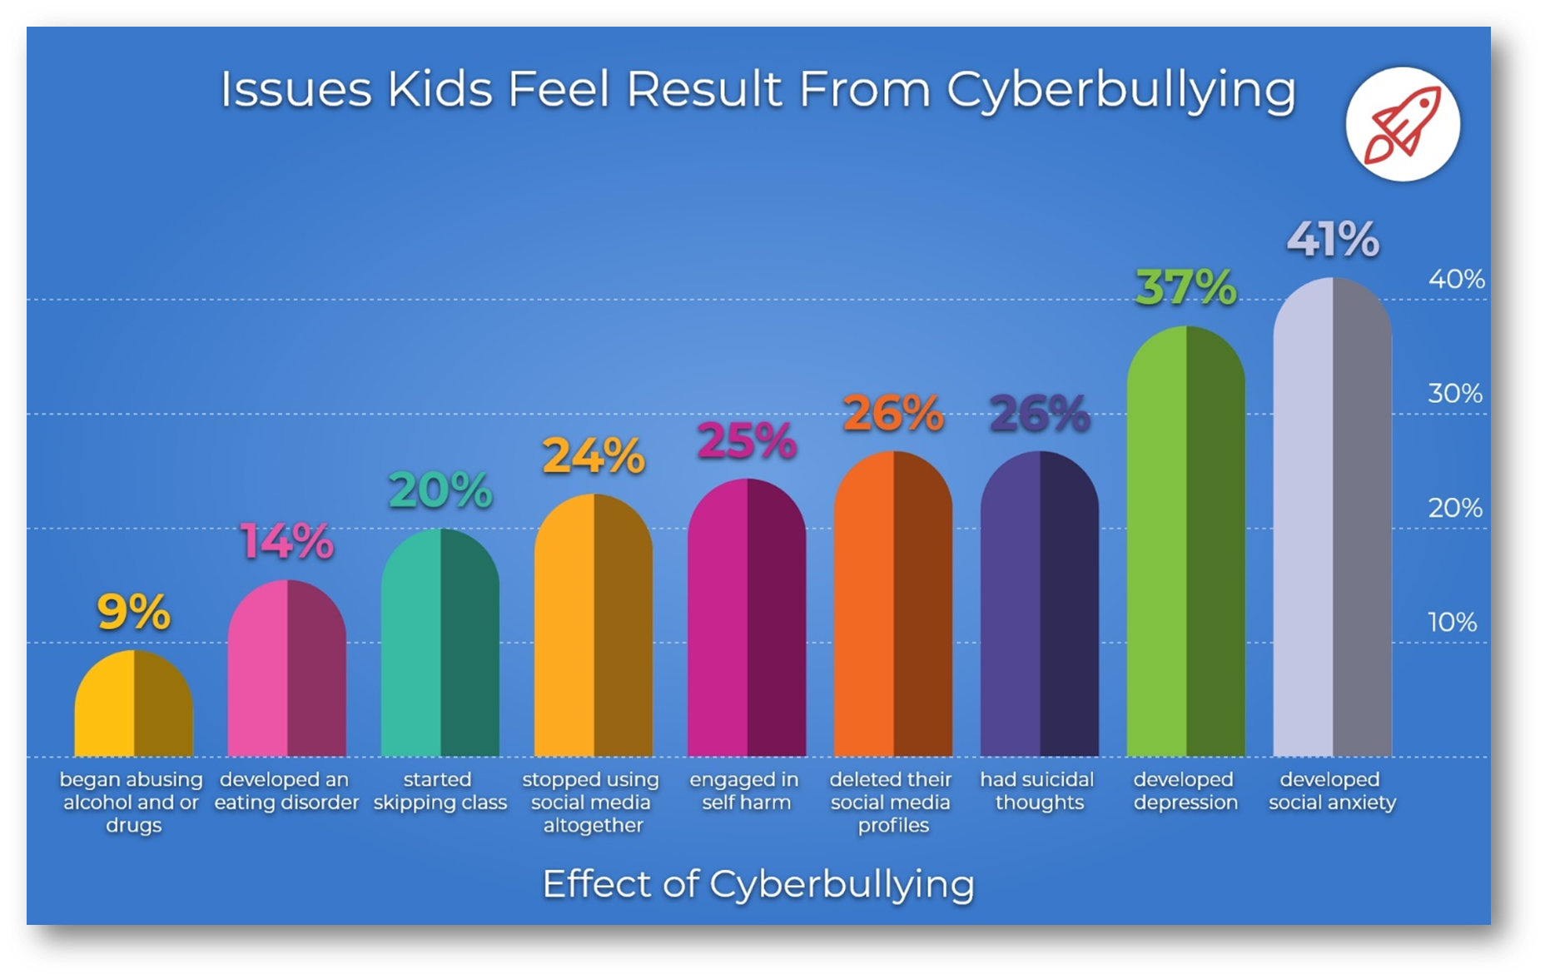
Notes:
Students that had been cyberbullied where asked to identify what issues they felt arose because of their experience with cyberbullying.
https://www.broadbandsearch.net/blog/cyber-bullying-statistics#post-navigation-0

Slide 16
Effects of Cyberbullying
Kids who are bullied can experience negative physical, social, emotional, academic, and mental health issues. Kids who are bullied are more likely to experience:
Depression and anxiety, increased feelings of sadness and loneliness, changes in sleep and eating patterns, and loss of interest in activities they used to enjoy. These issues may persist into adulthood.
Health complaints (headaches, stomachaches)
Decreased academic achievement—GPA and standardized test scores—and school participation. They are more likely to miss, skip, or drop out of school.
Notes:
https://www.stopbullying.gov/bullying/effects#suicide
https://www.broadbandsearch.net/blog/cyber-bullying-statistics#post-navigation-6

Slide 17
If you or someone you know is experiencing a mental health crisis or suicidal thoughts please call or text:
Notes:
Other hotlines for youth:
Loveisrespect.org (1.800.331.9474)
Peer advocates available 24/7 to support teens with concerns about dating violence. Chat available thru their website, or text loveis to 22522
Trevor Project Lifeline (1.866.488.7386) https://www.thetrevorproject.org/
Provides 24/7 crisis intervention and suicide prevention services to lesbian, gay, bisexual, transgender, and questioning youth.

Slide 18
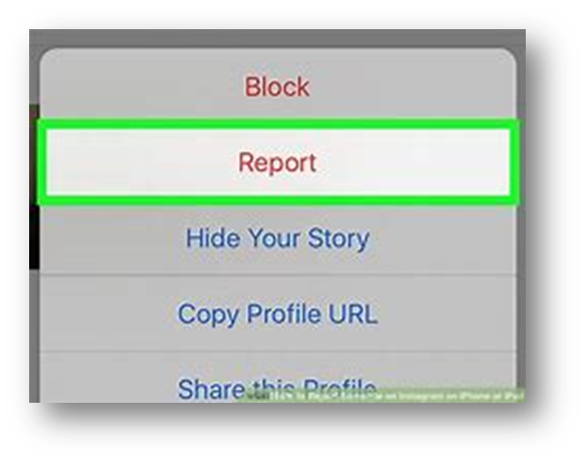
What if I’m being bullied online?
Being bullied might make you feel scared or helpless, or that there is nothing you can do to make it stop. But that is not true!
Talk to an adult you trust
Ignore and Block
Don’t bully the bully
Stick with your supporters
Report bullying when it happens
Notes:
Talk to an adult you trust
Talking to an adult is not “snitching.” A trusted adult can provide support and help to stop what is happening.
Ignore and Block
Ignore hateful messages and block any harassing accounts, emails or phone numbers.
Don’t bully the bully
Being kind and respectful (even to the bully) shows you are in control of your emotions and you won’t let their negativity bring you down.
Stick with your supporters
Talk about it with friends or people you can trust.
Report bullying when it happen:
You can report comments and accounts on the app or website you are using.

Slide 19
How Can I Help Prevent Cyberbullying?
Never contribute to cyberbullying, even if your friends encourages you to do it.
Don’t encourage bullies by “liking” or sharing their comments or posts.
Don’t spread rumors online. Call out misinformation and gossip.
Don’t forward mean messages.
Defend other people when they’re being bullied online.
Block and report harassers. (More on how to do this later)

Slide 20
Digital Abuse
Similar to cyberbullying.
It is the use of technology (such as texting and social media) to bully, stalk or harass someone, often a dating partner
Warning Signs
Monitors your friends and followers
Sends you negative, insulting or threatening messages
Uses social media to keep constant tabs on you
Puts you down online
Sends or asks for unwanted, explicit photos or videos
Steals or insists on giving up login info and passwords
Tags you unkindly in photos or posts
Notes:
22% of teen girls (ages 15-17) say someone has sent them explicit images they didn’t ask for, an act sometimes referred to as cyberflashing
8% had someone share explicit images of them without their consent, in what is also known as revenge porn
17% have been the target of persistent questioning about their whereabouts and activities
https://www.pewresearch.org/internet/2022/12/15/teens-and-cyberbullying-2022/

Slide 21
Your Digital Relationship Rights
You have the right to be away from your phone or social media without worrying that your partner will get mad.
You do not have to send any pictures or statements that you are uncomfortable sending.
You do not have to share your passwords with anyone that you are dating.
Remember that you lose control of any message you send out.
Loveisrespect.org or Text loveis to 22522
Notes:
Loveisrespect.org (1.800.331.9474)
Peer advocates available 24/7 to support teens with concerns about dating violence. Chat available thru their website, or text loveis to 22522

Slide 22
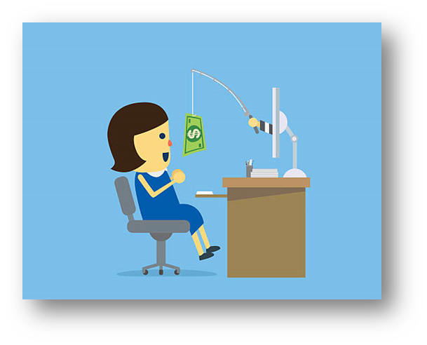
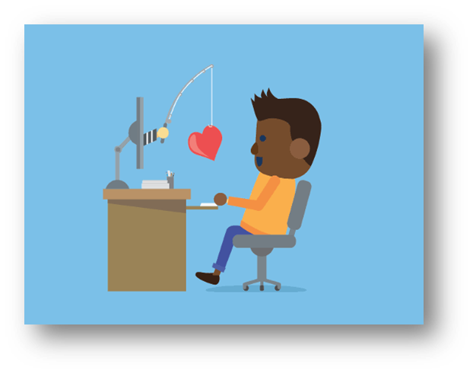
Catfishing
When a person creates fake personal profiles on social media sites with the intention to deceive, take advantage, and/or lure into an online relationship.
This is also a form of cyberbullying.
Teens are more likely to be victims of catfishing because they often accept friend or follow requests from people they do not know.

Slide 24
Oh no! You’ve been catfished. You have been talking to a 45 year old man from Minnesota. He’s a truck driver that talks to you thanks to McDonald’s wifi.

Slide 26
Whoops! You’ve been catfished. This is a scammer who lives in Mumbai. He has stolen the login and password for her account and is now scamming everyone she knows.

Slide 28
Great job! She is who she says she is! Kelly Heartwheel is a real person.

Slide 30
That’s unfortunate. You got catfished! Gigi isn’t so gorgeous. She’s a 70 year old woman with 5 grandkids. She enjoys crocheting, murder mystery novels, and catfishing unsuspecting teens.

Slide 31
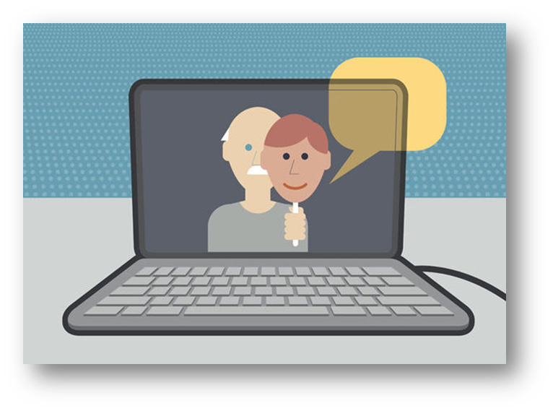
Why Would Someone Catfish?
Embarrassed of their true self
Like the attention that comes from pretending to be someone else (older, younger, different gender, etc.)
To bully, trick, or embarrass someone else.
To gain trust, then take advantage of someone (emotionally, financially, sexually)

Slide 32
Warning Signs of Catfishing
Refuses to speak on the phone or video chat
Tries to form a strong bond with you as soon as possible
Asks you for $$$$$$
All photos appear to be professionally taken
Too many or too few internet friends/followers
Travels a lot for work/school, but is never in your area
Avoids in-person contact/always makes excuses
Notes:
If you suspect someone is catfishing you:
Do not share any of your personal information.
Consider ending communication with them.
Never meet up with them alone.

Slide 33
Human Trafficking
Notes:
The next few slides talk about Human Trafficking. Please review for age appropriateness.

Slide 34
What is Human Trafficking?
Human trafficking involves the use of force, fraud, or coercion to obtain some type of labor or commercial sex act. Every year, millions of men, women, and children are trafficked worldwide – including right here in the United States. It can happen in any community and victims can be any age, race, gender, or nationality.
Traffickers might use the following methods to lure victims into trafficking situations:
Violence
Manipulation
False promises of well-paying jobs
Romantic relationships
Notes:
https://polarisproject.org/human-trafficking-and-social-media/

Slide 35
Human Trafficking and Social Media
Perpetrators may use social media to start a friendship or relationship with someone to gain their trust. Once trust is established, they may use the relationship to convince them into going somewhere and/or meeting.
They do this by pretending:
To offer friendship and understanding
To be in love
To offer housing
To offer a job or opportunity such as modeling or acting

Slide 36
Who is most vulnerable?
People you know might be vulnerable to trafficking if they:
Have an unstable living situation
Have a history of domestic violence
Has a caregiver or family member who has a substance abuse issue
Are runaways or involved in the juvenile justice or foster care system
Are undocumented immigrants
Are facing poverty or economic need
Have a history of sexual abuse
Are addicted to drugs or alcohol
Notes:
Anyone can be trafficked, in any community, just as anyone can be the victim of any kind of crime. But the real story is that while it can happen to anyone available evidence suggests that people of color and LGBTQ+ people are more likely to be trafficked than other demographic groups.
https://polarisproject.org/vulnerabilities-and-recruitment/

Slide 37
Grooming, Exploitation, and Control
Contrary to popular misconceptions, sex trafficking rarely begins with kidnapping by a stranger. Instead, sex traffickers groom their victims by using love – romantic love, friendship and familial love – to manipulate them into cooperating in their own exploitation.
In 2020, 42% of trafficking victims were brought into trafficking by a member of their own families and 39% were recruited via an intimate partner or a marriage proposition.
Notes:
What is Grooming?
Sex traffickers carefully and methodically work to gain their victims’ trust, create a degree of dependence, and subtly promote the idea that selling sexual services is normal, acceptable and necessary. Ultimately, successful grooming results in vulnerable people cooperating in their own exploitation and abuse and believing they have made the choice to do so independently.
https://polarisproject.org/love-and-trafficking/

Slide 38
Busting the Myths
Myth: Human trafficking is always a violent crime.
Fact: Most traffickers use psychological means (defrauding, manipulating, threatening, etc.) to coerce victims.
Myth: Only women and girls can be victims and survivors of sex trafficking.
Fact: People of all genders are victimized by sex traffickers. Boys and young men apart of the LGBTQ+ community are particularly vulnerable to trafficking.
Notes:
https://polarisproject.org/myths-facts-and-statistics/

Slide 39
Busting the Myths
Myth: If the trafficked person consented to be in their initial situation, then it cannot be human trafficking or against their will because they “knew better.”
Fact: Initial agreement prior to acts of force, fraud, or coercion (or if the victim is a minor) is not relevant to the crime, nor is payment.
Myth: People being trafficked are always physically unable to leave their situations, are locked in, or held against their will.
Fact: It is common for survivors to stay due to more complicated reasons, such as lacking the basic necessities (transportation, housing, etc.) to physically get out. Some survivors may be afraid for their safety or may not identify as being under the control of another person.
Notes:
https://polarisproject.org/myths-facts-and-statistics/

Slide 40
To get help from the National Human Trafficking Hotline
Call 1-888-373-7888
or text HELP or INFO to BeFree (233733)
To report suspected human trafficking
Call 1-866-347-2423

Slide 41
How do I Stay Smart and Safe Online?

Slide 43
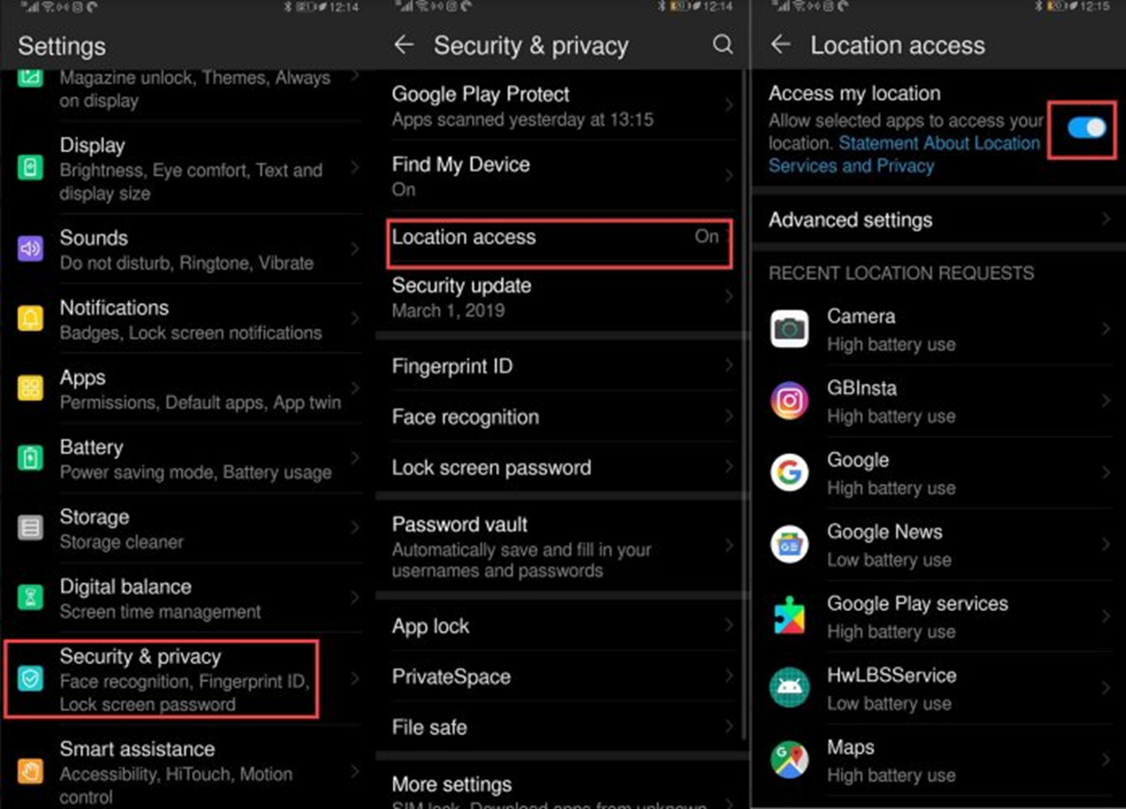
Privacy and Location Settings Keep your devices locked and password protected. Be aware of when your phone is using your location:
Notes:
*1st click for iPhone settings*
*2nd click for Android settings*

Slide 44
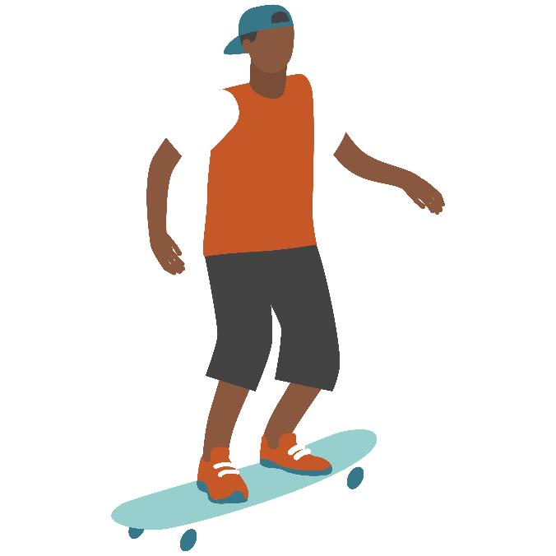
You Are In Control of Your Settings
Many apps’ default settings allow them access to your location services
If an app is not location-based, then it doesn’t need your location
You can change these settings and choose which apps can use GPS
You can also allow different degrees to which apps can use this information

Slide 45
When to use Location
Location ON only while using:
Maps/GPS
Weather
Siri
Location-based apps such as Lyft, Uber, Fitbit, etc.
Location OFF while using:
Camera
Facebook
Instagram
Twitter
Snapchat
Tik Tok
Notes:
Other examples of apps that need location to work and those that don’t?
Most apps you can set to “location only when using app” or “approximate location” instead of “exact location.”
*Remember to exit out of apps when you are done using, so the app will not continue to use your location!

Slide 46
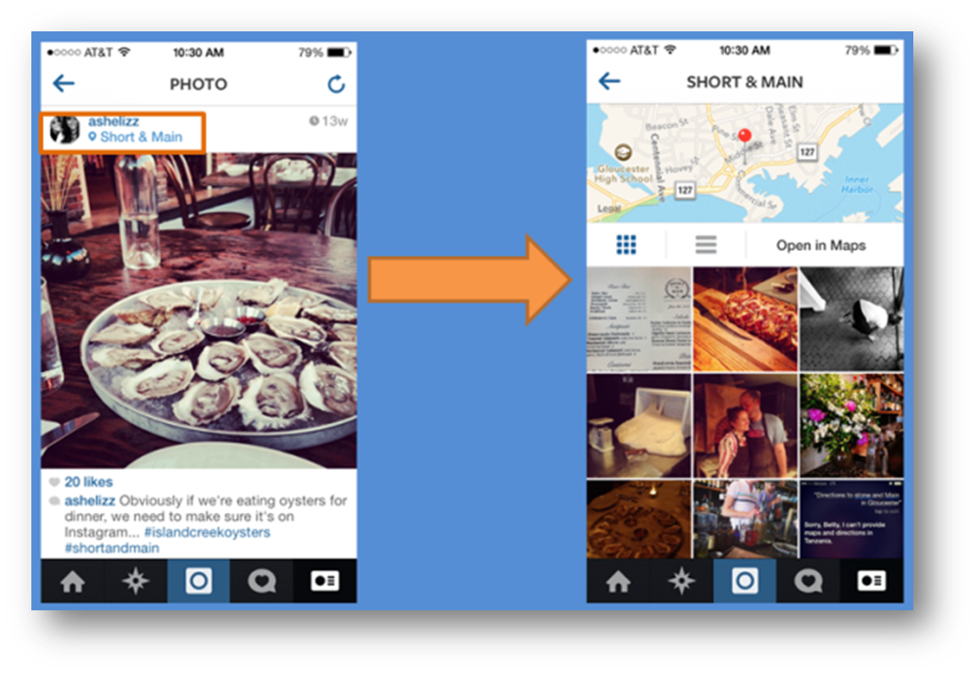
By turning ON location on social media apps, anyone that follows you can see exactly where you are on the map:
Notes:
This is a safety issue, especially if your profiles/posts are public.
(images are from snapchat and Instagram)

Slide 47
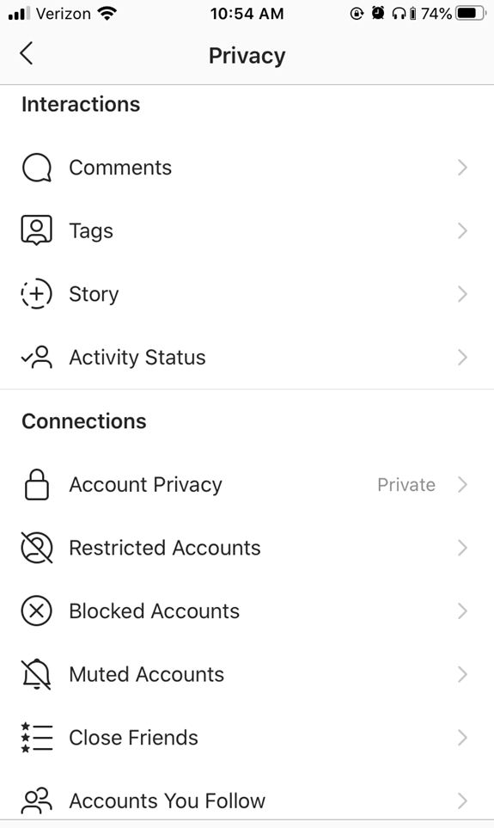
Privacy and Reporting
Notes:
Go to Settings > Privacy
Comments
Filter who can and cannot comment on your photos and videos
Block inappropriate or offensive words from your comment section
Tags
Filter who has to ask permission to tag you in a post
Untag yourself in posts
Story
Decide who can see your story and mute stories you do not want to see
Activity
Decide who can see when you are active on Instagram
Set your account to Private so only people you approve can see your photos and videos
Restrict accounts to protect yourself from unwanted interactions without having to block or unfollow them. You have to give approval for their comments to show up on your posts.
Block accounts you want zero interaction with.
Reporting - To report an account or comment that includes spam, bullying, harassment, discrimination or is inappropriate go to the account, tap the 3 dots in upper right corner, tap Report and follow prompt.

Slide 48
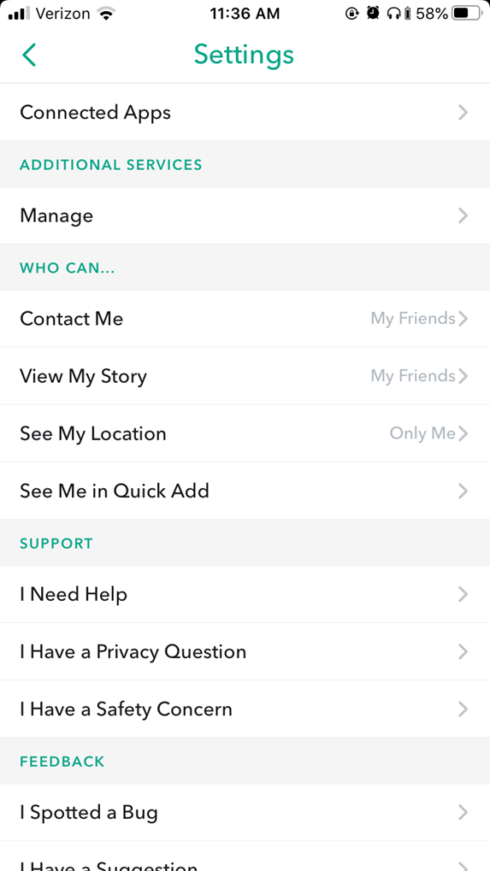
Privacy and Reporting
Notes:
Contact Me – decide who can message you on Snapchat
View My Story – decide who can view your story
See My Location – decide who can see your location and if you’ll show up on the map
See Me in Quick Add – decide if you want to be suggested for people to add as friend
Reporting – report someone’s story, a snap they sent you, or a snapchat account

Slide 49
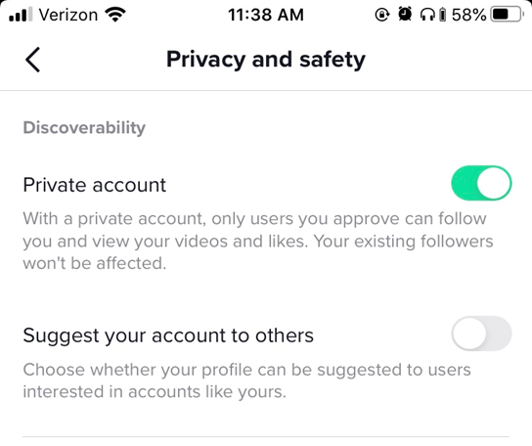
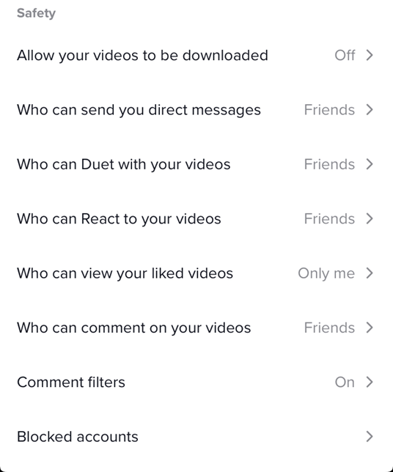
Privacy and Reporting
Notes:
Go to Profile > 3 dots in upper right corner > Privacy and Safety
Privacy
1. Make account Private so you can approve who can follow you and view your videos
2. Choose if your profile can be suggested for other users to follow
3. Decide if your videos can be downloaded by other users
4. Decide who can duet your videos
5. Decide who can React to your videos
6. Decide who can view videos you’ve liked
7. Decide who can comment on your videos
8. Filter out spam or offensive comments and/or choose specific words you don’t want to see in your comments
Reporting
- Go to user’s account, tap 3 dots in upper right corner, tap Report and follow prompt.

Slide 50
Remember
Social media is supposed to be a fun place to connect, share creativity etc. Stay smart and keep yourself safe by using your privacy settings to your advantage!
Only report something or someone when you see spam, inappropriateness, discrimination, bullying, harassment and/or abuse. Do not report as a joke, to be funny, or to bully someone.

Slide 51
Take A Break!
Spend more time on yourself and what you like, and less time on what others are doing.
Break the cycle of comparing yourself and your life to others.
Remember: Social media is often just a highlight reel of people’s best moments.
Increase ability to focus on your own goals.
Better sleep and healthier habits.

Slide 52
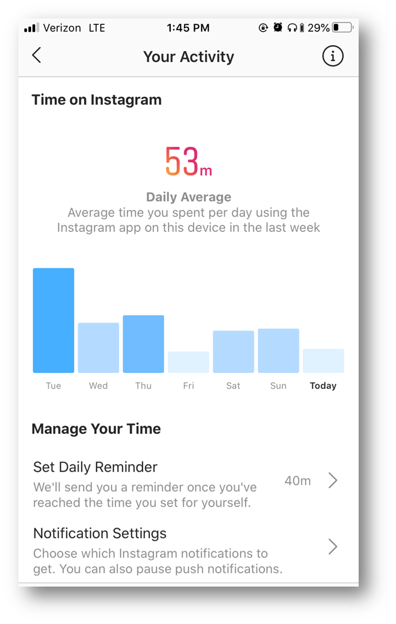
Limit Your Time
Notes:
Instagram: Go to your profile > 3 lines in upper right corner > Your Activity
Track how much time you are scrolling on Instagram each day.
Set a daily limit to your time spent scrolling each day. You will receive a reminder when you’ve reached your limit.
Choose which notifications you want to get. This helps manage how much you are reaching for your phone to check a notification.
TikTok: Your profile > 3 dots in upper right corner > Digital Wellbeing
Set a daily limit for your scrolling time on TikTok. After limit is reached, you will need a password to get in.
You can also put your phone on “sleep mode” or “do not disturb” so you don’t get notifications while you’re sleeping or certain times you want to disconnect without turning off your phone.

Slide 53
For more information and resources visit: www.Centerstoneteen.org

