Slide 1
Systems of Care At Work
Applying Principles of Systems of Care into Community and School Partnerships
Niki Grajewski, LCSW
Megan Ragan, MSW
Taylor Marks, LCSW

Slide 2
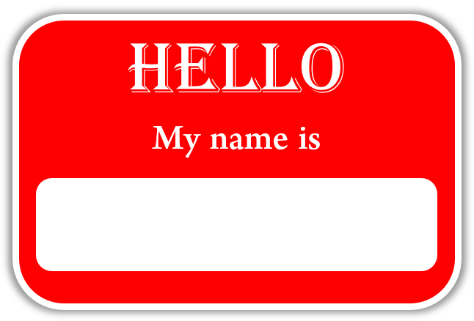
Introductions
Meet your facilitators & tell us about you!!
School Counselor
School Social Worker
Administrator
Length of time in education?
Region of State employed?
Familiarity with Systems of Care principles and philosophy?
Notes:
Each facilitator introduce self, a little about history, and fun fact

Slide 3
Agenda
Overview of Mental Health Systems of Care
Community and School Integration – Program Overview
  Building Compassionate Communities
  TREE and Flourish
  CT3
Wrap Up
Questions
Notes:
Today we are going to discuss how we at Centerstone, a community mental health center, have woven Systems of Care philosophy and principles into the work we do with local school districts and community partners.
We will provide an overview of Systems of Care and why we think they are important in supporting children and families, as well as how each of our individual programs have utilized SOC into the work that we do.
After that we will wrap up with how this collaborations such as these have positively impacted youth, providers, and schools in our region and answer any questions.

Slide 4
Notes:
Discuss and overview of Centerstone as an agency.

Slide 5
Centerstone at a glance

Slide 6
Definition of a System of Care
A system of care incorporates a broad, flexible array of effective services and supports for a defined population that is organized into a coordinated network, integrates care planning and management across multiple levels, is culturally and linguistically competent, builds meaningful partnerships with families and youth at service delivery, management, and policy levels, has supportive policy and management infrastructure, and is data-driven.
Notes:
Read definition, and then break it down a little bit.
Broad, flexible array of effective services and supports –
Coordinated network –
Integrated care management and planning –
Culturally and linquistically competent –
Partnerships with Families and Youth –
Data driven -

Slide 7
Historic/Current Systems Problems
Lack of home and community-based services and supports
Cost
Rigid financing structures
Administrative inefficiencies; fragmentation
Knowledge, skills and attitudes of key stakeholders
Patterns of utilization; disproportionality and disparities
Poor outcomes
Deficit-based/medical models, limited types of interventions
Pires, S. (1996). Human Service Collaborative, Washington, D.C.
Notes:
Some of the historic and or current problems facing not only children and families but the systems in which they live are on the slide you see here.
Go over some of the historic/current system problems. Ask for brief feedback if participants have seen this in their communities as well.

Slide 8
Alignment with CASSP Principles
1) Services are child-centered
2) Services are family-based
3) Services are community-based
4) Services are multi-system
5) Services are culturally competent
6) Services are least restrictive and intrusive as possible
Notes:
Brief History
A national study in 1982 found that two-thirds of all children with severe emotional disturbances were not receiving appropriate services. These children were "unclaimed" by the public agencies responsible to serve them, and there was little coordination among the various child-serving systems. To address this need, Congress appropriated funds in 1984 for the Child and Adolescent Service System Program (CASSP), envisioned as a comprehensive mental health system of care for children, adolescents and their families.
CASSP Core Principles
CASSP is based on a well-defined set of principles for mental health services for children and adolescents with or at risk of developing severe emotional disorders and their families. These principles are summarized in six core statements.
• Child-centered: Services meet the individual needs of the child, consider the child's family and community contexts, and are developmentally appropriate, strengths-based and child-specific.
• Family-focused: Services recognize that the family is the primary support system for the child and participates as a full partner in all stages of the decision-making and treatment planning process.
• Community-based: Whenever possible, services are delivered in the child's home community, drawing on formal and informal resources to promote the child's successful participation in the community.
• Multi-system: Services are planned in collaboration with all the child-serving systems involved in the child's life.
• Culturally competent: Services recognize and respect the behavior, ideas, attitudes, values, beliefs, customs, language, rituals, ceremonies and practices characteristic of the child's and family's ethnic group.
• Least restrictive/least intrusive: Services take place in settings that are the most appropriate and natural for the child and family and are the least restrictive and intrusive
CASSP Principles are a part of System of Care Principles for sure and help drive how to do this type of work, who to do it with, and where to do it.

Slide 9
Characteristics of Systems of Care as
Systems Reform Initiatives
FROM
Fragmented service delivery
Categorical programs/funding
Limited services
Reactive, crisis-oriented
Focus on “deep end,” restrictive
Children/youth out-of-home
Centralized authority
Foster “dependency”
TO
Coordinated service delivery
Blended resources
Comprehensive service array
Focus on prevention/early intervention
Least restrictive settings
Children/youth within families
Community-based ownership
Build on strengths and resiliency
Pires, S. (2010). Building systems of care: A primer, 2nd Edition. Washington, D.C.: Human Service Collaborative for Georgetown University
National Technical Assistance Center for Children’s Mental Health.
Notes:
This slide overviews some of the differences between how systems that serve children and families might ‘typically’ function and how they might look different in Systems of Care.

Slide 10


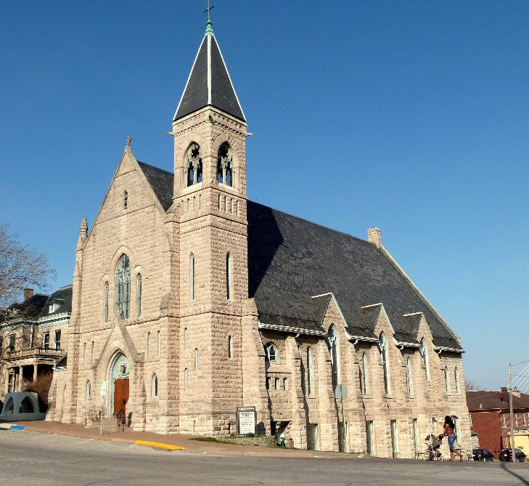
System of Care Partners
Parents
Youth
Mental Health Providers
Schools
Child Welfare
Juvenile Justice
Medical Staff
Natural Supports
Notes:
One of the biggest reasons that Systems of Care has been thought and proven to work well for children and families is due to the people that Systems of Care bring to the table, so to speak, to support a child and family.
When the agencies, schools, and others work together, rally around a child and family, and work together, the outcomes for children and families are far better. Depending on who is involved in a child’ and families life, and this may be just mental health and school, or all the systems you see listed here, when they sit around the same table, listen to the child and family, and come up with a mutual plan to address identified needs, great changes can happen.
The idea of serving children through silos of care – mental health does this solo, school does that solo, dcfs does this solo and no one talks to each other don’t work as well.
Developing partnerships between community agencies, schools, and others before work begins with children and families using a System of Model, is very important.
Building gaps in services, creating working relationships, and supporting each other as partners in the system is part of the work.
Next we will highlight for you some of the ways in which we have put these princples into practice to build a comprehensive System of Care for our Region.

Slide 11
Building Compassionate Communities
Strengthening child and family resiliency through a trauma-informed system of care

Slide 12
Tier 1: Community Compassion, and Wellness
*Community Mental Health Campaign
Tier 2: Prevention, Wellness, and Resiliency
*Community Based Family Resource Developers
Tier 3: Service Coordination
*Electronic Referral System (IRIS)
*Community Wide Professional Training
*Caregiver/Parent Education and Training
*Creating Compassionate Communities
*Client Assistance Funds
*Initial Screening for Health/Mental Health Needs
*Increased Caregiver Competence, Resiliency, Confidence and Support
*Social - Emotional Prevention Services
*High Fidelity Wraparound
*Comprehensive Assessment/Treatment Plan
*Family Peer Advocates/Coaches
*MAP/Practicewise - Evidence informed care planning

Slide 13
Projected Outcomes
Further Integration of MH into schools – Increase to 85%
Increase in school attendance – Truancy decrease by 15%
Increase in Peer Provided Services – Parent Supports
Decrease in crisis referrals
Decrease in parent depression
Increase in availability of Evidence Based / Informed Practices (MST, High Fidelity Wraparound, TFCBT, etc.)

Slide 14
CT3: Centerstone Trauma, Training and Treatment

Slide 15
Project Goals
Tier 3
Tier 2
Tier 1
Trauma-focused intervention
Trauma-informed intervention, care coordination, consultation and support
Providing training to build community capacity
Notes:
Mobilize and build local capacity and community resources among child-serving systems
Train and educate professionals and community members/stakeholders regarding trauma-informed practices, trauma identification and awareness, and/or cultural competence
Provide training in evidence-based models such as TF-CBT, YMHFA, and Seeking Safety
Screen children and families referred for trauma symptomology, substance use, and/or co-occurring mental health disorders
Utilize the Care Process Model to triage clients to appropriate evidence-based trauma informed and/or trauma focused interventions
Provide assertive outreach and engagement, care management, prevention services, and evidence-informed/evidence-based treatment to children and families

Slide 16

What Makes CT3 Different
CT3: Programming designed with trauma survivors in mind
Notes:
Quick access to clinicians with training in evidence-based practices including TF-CBT, EMDR, PCIT, and CPP.
Collaborative care coordination through a trauma-informed lens
Whole family approach to trauma treatment
Collaboration with all entities connected to the family system (schools, physicians, DCFS, etc)

Slide 17

Program Eligibility
Notes:
Any child age 2-17 with symptoms of traumatic stress
Not every child will require a trauma-focused intervention
Trauma Assessment
TSCC/TSCYC Results
Clinical consultation among the client and/or their caregiver, the clinician, and other relevant CT3 personnel

Slide 18



Target Training Audience
Education systems, social services and child welfare agencies
Primary care providers, law enforcement, public health
Churches, foster parents, caregivers, community members

Slide 19
Youth and Family TREE

Slide 20
Youth & Family TREE (TREE)
Substance use and tobacco/nicotine cessation program
Age 12 - 25
Includes individual, group, and families sessions
Sessions occur in the Centerstone office, within schools, via telehealth, and/or in the home
Referred by:
  Self
  School social worker/counselor/administration
  Medical Professionals
  Parents
  Child Welfare
  Anyone who thinks this program can help!

Slide 21
Student Staying Sober
TREE program
Family/
Friends
Probation
School Staff
Child Welfare
Courts
Notes:
In order to support our clients recovery and sobriety we rely on all systems to work together on this goal.
- TREE program – providing the SU intervention and education, Recovery Specialist support (peer work)
School staff – promote recovery/sobriety/treatment, updating policies regarding how they respond to students using substances (lesser consequence if they engage in treatment), support academics, encourage daily use of learned skills for recovery
Family – encourage use of skills, remove substances and temptations, provide support (transportation, telehealth access, etc.)
Other agencies – possibly assists with urinalysis, mandates treatment when needed, provides resources, etc.
How do we work together?
Providing ongoing updates
Meetings with all of the systems
Problem solving barriers – who has the resources to meet the need?

Slide 22
Flourish

Slide 23
Flourish
Families who have a DCFS case
Substance use is involved in the case
Goals:
  Involve the entire family in treatment
  Build healthy relationships within the family
  Improve parenting skills
  Decrease/eliminate trauma, substance use, mental health symptoms, behavior concerns
  Keep families together SAFELY

Slide 24
Flourish Systems
Parent/Child/Family
- Willingness to learn
Supportive People
Child Welfare
- Goals for treatment
- Insight about the family
Treatment
Resources
- Family
- Friends
-School Staff
- Foster Parent
- Treatment Providers
- Link to services
- Resources
- Service Plan
- Counseling
- Urinalysis
- Psychiatry
- Family Support
-Transportation
- Telehealth Devices
- Housing
- Food
Healthy, Safe, United Family
Notes:
In order for Flourish families to be strengthened, we need the support of all systems.
Parent/Child/Family:
All family members showing up, willing to grow and learn, open to moving forward
Supportive People:
People who want this family to succeed, provide support to the family, help overcome barriers.
Child Welfare:
Ensure family is safe, link to services to meet goals
Treatment:
This is important for EVERY family member in this system. The system can’t grow together unless everyone is getting their needs met.
Resources:
- Hierarchy of needs, ability to engage in the necessary services, etc.
Case example discussion.

Slide 25

Wrap Up
Notes:
Discuss philosophy of systems of care work – overall goal to ensure children and families have what they need to achieve wellness and to thrive.
To do that we have to all work together, remain creative, and find ways as individual systems to not only support the families around us, but to help sustain each other.
It’s not about me or you, it’s about “us”. “All together working side by side to provide for the communities in which we serve.

Slide 26

Questions?
Niki Grajewski, LCSW - nicole.grajewski@Centerstone.org
Taylor Marks, LCSW – taylor.marks@Centerstone.org
Megan Regan, MSW – megan.regan@Centerstone.org

